Slide 1
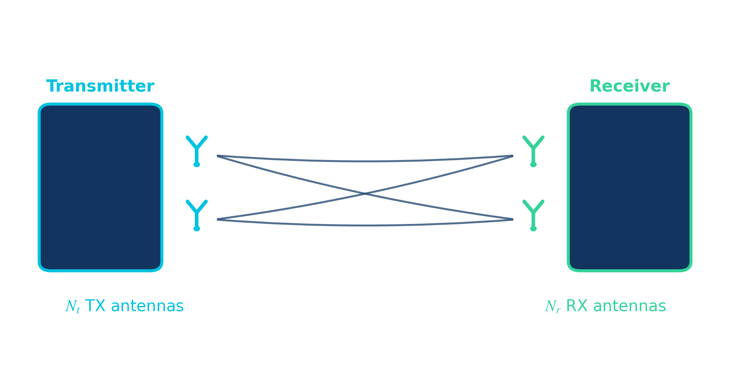
ADVANCED WIRELESS COMMUNICATION
Transmit Diversity &
Space-Time Coding
Improving reliability in wireless systems — from MRT beamforming to the Alamouti code
PG Diploma in Advanced Communication with Quantum & AI
180-minute lecture session
01

Slide 2
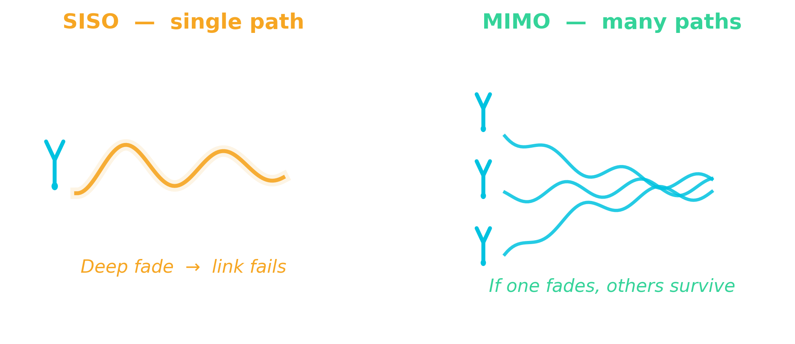
MOTIVATION
Why do we need diversity?
Wireless channels corrupt the signal
▸ Multipath fading & deep fades
▸ Shadowing and attenuation
▸ Random, time-varying channel gain
Result: higher BER, packet loss, outages
Goal: improve reliability without extra bandwidth or power
02

Slide 3
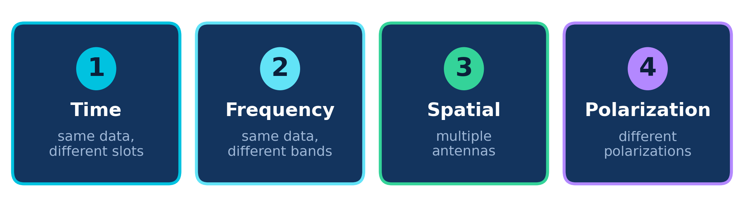
FUNDAMENTALS
Four ways to create diversity
Core idea: send the information over independently-fading channels, so the chance that all of them are in a deep fade at once becomes very small.
This lecture focuses on spatial transmit diversity — using multiple transmit antennas to fight fading.
03

Slide 4
CONCEPT CHECK · QUIZ 1
Name that diversity
?
Using several antennas to send a signal over independently-fading paths is which kind of diversity?
Time diversity
Frequency diversity
A
B
Spatial diversity
Polarization diversity
C
D
Answer on the next slide →

Slide 5
ANSWER · QUIZ 1
Name that diversity
Q: Using several antennas to send a signal over independently-fading paths is which kind of diversity?
Time diversity
Frequency diversity
A
B
✓ correct
Spatial diversity
Polarization diversity
C
D
WHY
Spatial diversity uses physically separated antennas, so their fades are (nearly) independent — the basis of transmit/receive diversity and MIMO.

Slide 6
SYSTEM MODEL
MIMO: Multiple-Input Multiple-Output
Array gain
coherent combining lifts average SNR
Diversity gain
parallel paths fight deep fades
Multiplexing gain
parallel streams raise data rate
Today: the diversity gain branch.
04

Slide 7
CONCEPT
What is transmit diversity?
Basic idea
The central question
Instead of transmitting through one antenna, send the same information through multiple transmit antennas.
How should the signals be transmitted from the different antennas?
▸ Reduces the impact of fading
▸ Improves received SNR
▸ Improves BER performance
Two answers: with CSIT (beamforming) and without CSIT (space-time coding).
05

Slide 8
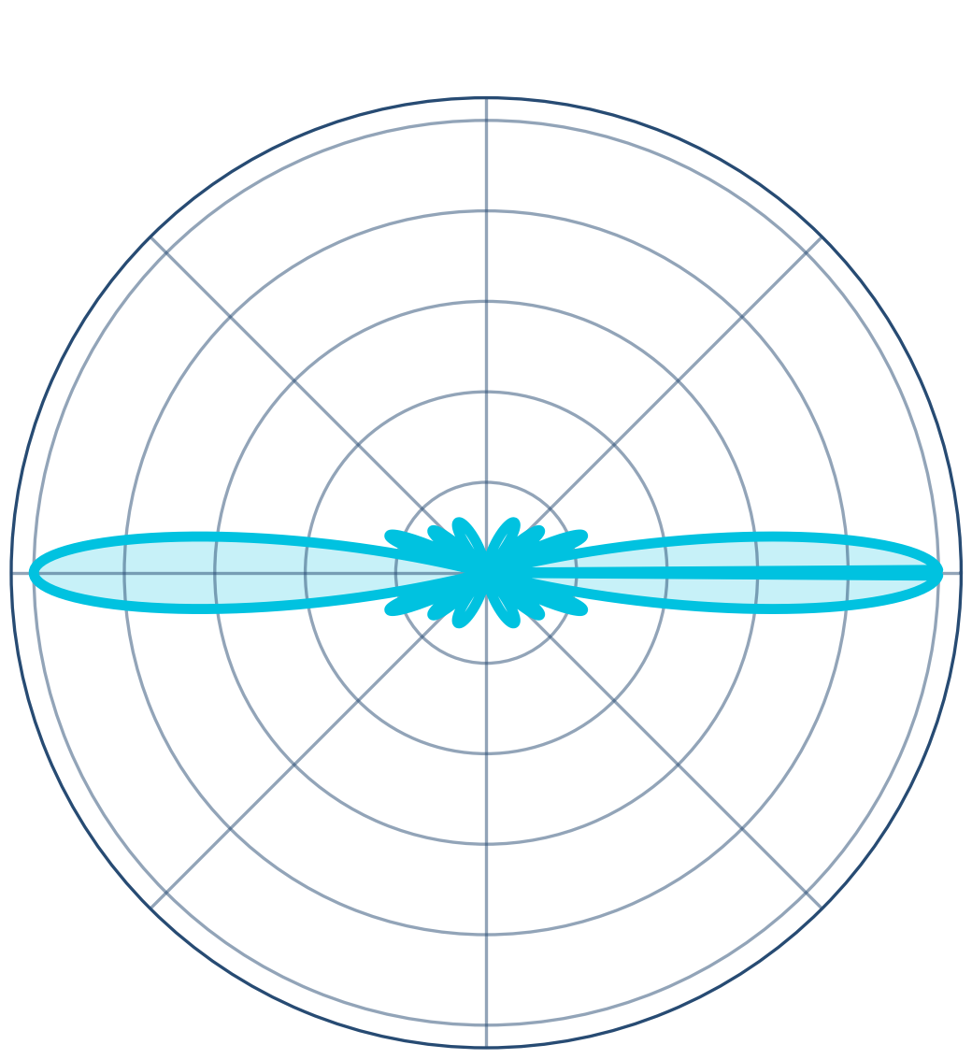
APPROACH 1 · WITH CSIT
Beamforming: smart transmission
Don't transmit equally from all antennas.
Adjust the amplitude and phase of each antenna's signal so the copies add constructively at the receiver.
Objective
Steer transmit energy toward the receiver — maximise the signal power that arrives.
06

Slide 9
APPROACH 1 · WITH CSIT
Maximum Ratio Transmission (MRT)
Principle
Transmit in the direction of the channel.
Key idea
Weight each antenna by the channel it sees.
Objective
Maximise the received SNR.
Requirement
Channel State Information at the Transmitter (CSIT).
07

Slide 10
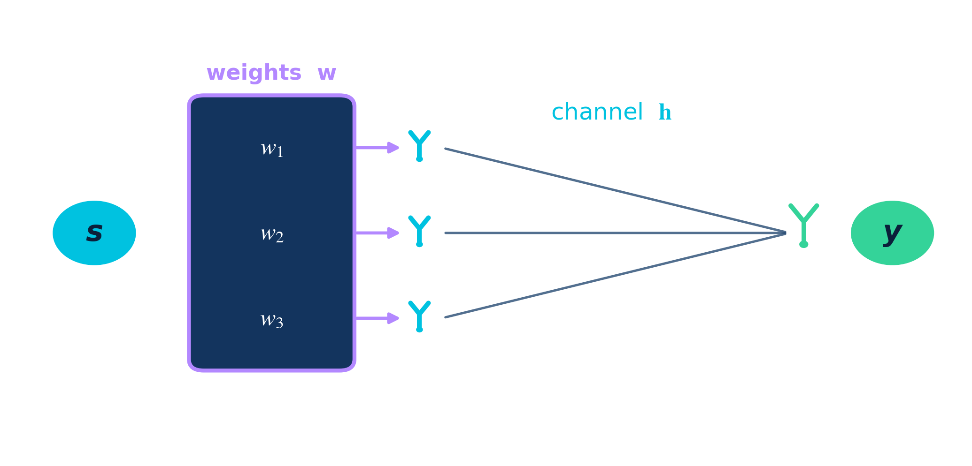
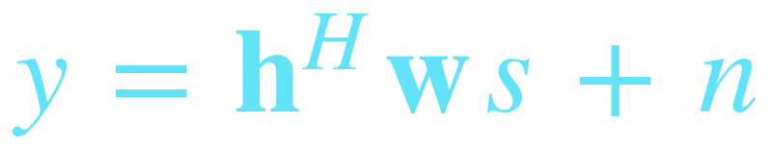
DERIVATION
MRT system model
Notation
h
channel vector
w
beamforming weights
s
transmitted symbol
n
noise
y
received signal
08

Slide 11

DERIVATION
The optimisation problem
Find the beamforming vector that maximises received SNR under a power budget:
Maximise
Subject to
received SNR — the useful signal power over noise
a fixed total transmit power constraint
09

Slide 12
DERIVATION · KEY RESULT
Deriving the optimum
1
Write received SNR
2
Apply Cauchy–Schwarz
3
Equality condition
proportional to |hᴴw|²
bound the inner product
w must align with h
Equality — and therefore maximum SNR — holds exactly when w ∝ h.
10

Slide 13
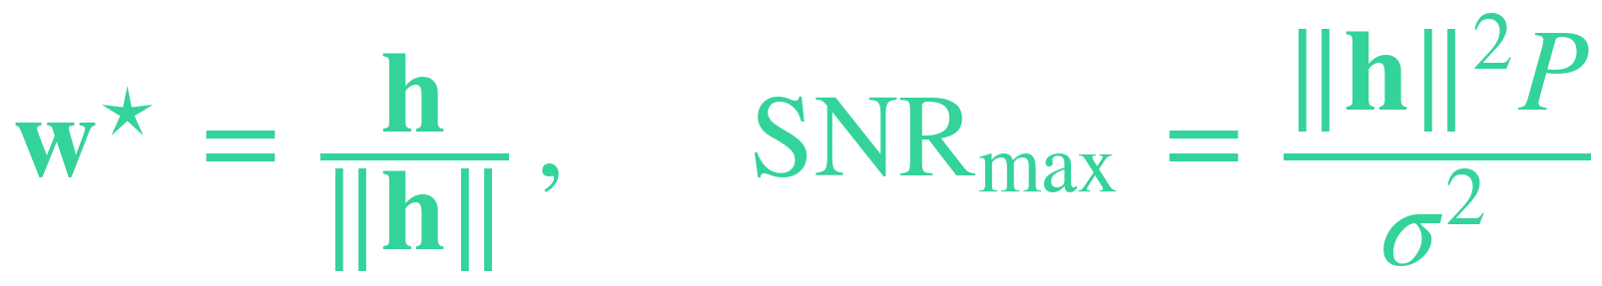
RESULT
The MRT beamforming vector
Optimal weights
Interpretation
▸ Each antenna is matched to the channel it sees
▸ Receiver combines with the same direction (MRC)
▸ All antenna copies add up coherently → maximum SNR
Transmit energy is poured exactly along the channel direction.
11

Slide 14
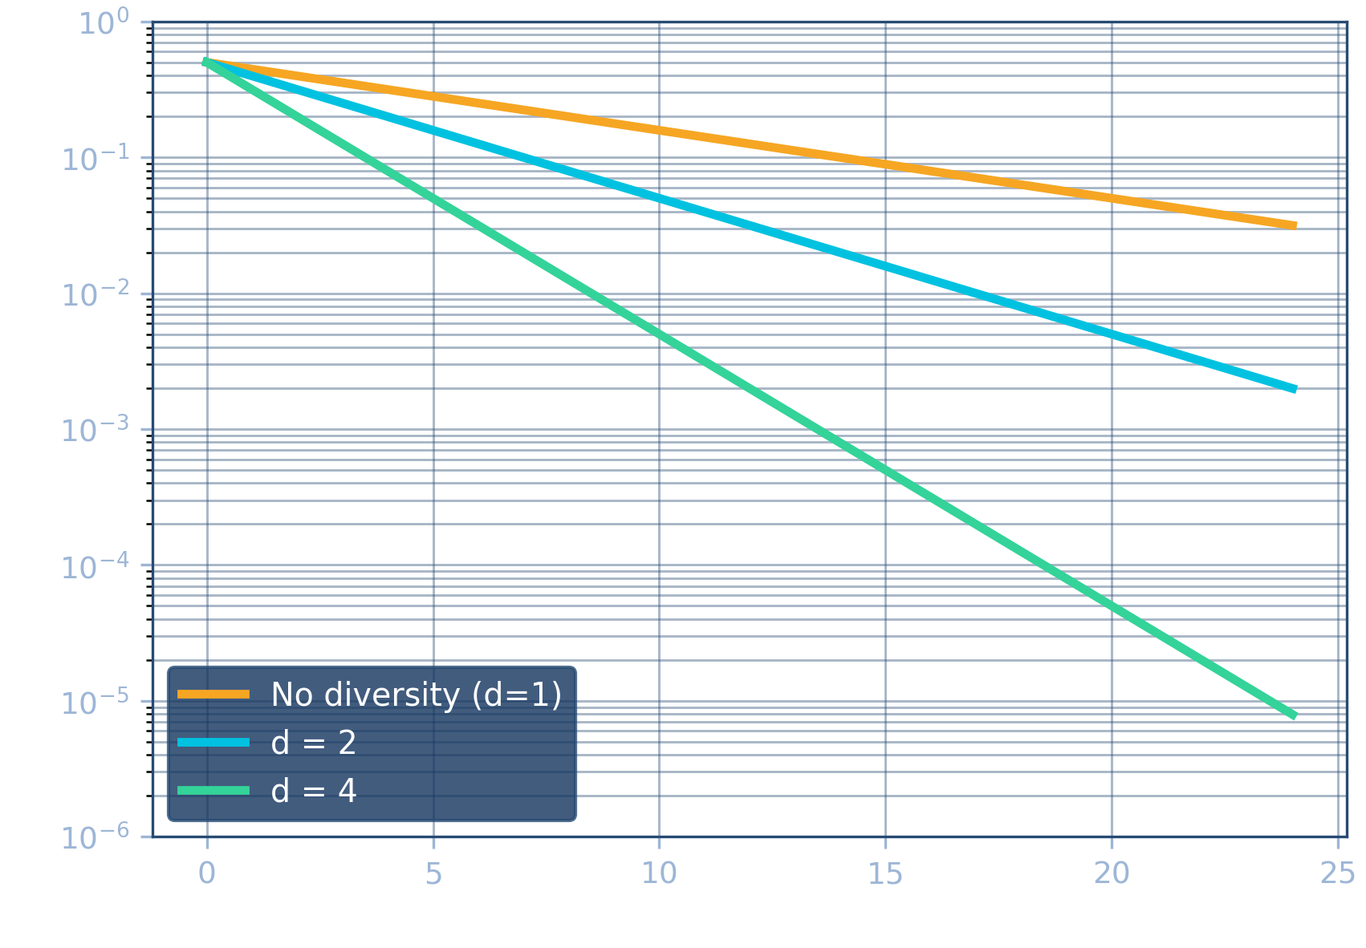
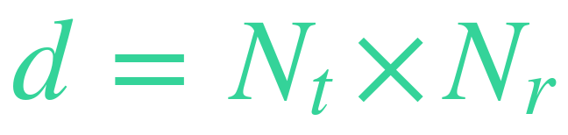
PERFORMANCE
Diversity gain of MRT
Achievable diversity order
▸ Full spatial diversity Nt × Nr
▸ Maximum possible received SNR
▸ Steeper BER curve = stronger diversity
12

Slide 15
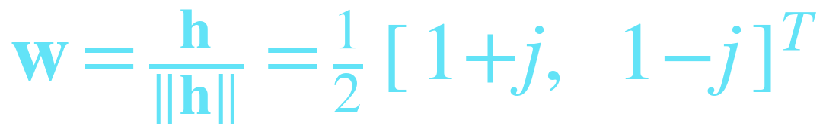
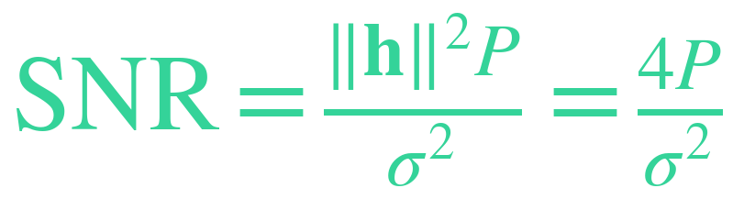
WORKED EXAMPLE · MRT BEAMFORMING
Design an MRT beamforming vector
Given: channel h = [ 1+j , 1−j ]ᵀ , transmit power P , noise variance σ²
1
Channel norm
2
Weight = matched to channel
3
Received SNR
RESULT
w points energy along the channel direction; SNR = 4P/σ² — about 3 dB array gain over the best single antenna, plus full 2-branch diversity.
13

Slide 16
THE CATCH
Limitations of MRT
MRT needs to know the channel
So we ask...
▸ Requires perfect CSIT at the transmitter
▸ Needs a feedback channel
▸ Feedback overhead grows with antennas
▸ Estimation errors & mobility break it
Can we get diversity without channel knowledge at the transmitter?
14

Slide 17
CONCEPT CHECK · QUIZ 2
How MRT points its energy
?
MRT beamforming maximises the received SNR by pointing the transmit weight vector w …
in a fixed direction
along the channel, w = h / ‖h‖
A
B
orthogonal to the channel
randomly in each slot
C
D
Answer on the next slide →

Slide 18
ANSWER · QUIZ 2
How MRT points its energy
Q: MRT beamforming maximises the received SNR by pointing the transmit weight vector w …
in a fixed direction
✓ correct
along the channel, w = h / ‖h‖
A
B
orthogonal to the channel
randomly in each slot
C
D
WHY
MRT aligns w with the channel so the antenna copies add coherently — maximum SNR. That alignment is exactly why MRT needs CSIT.

Slide 19
APPROACH 2 · NO CSIT
Diversity without CSIT
First attempt — repetition: send the same symbol from each antenna in turn.
✓ Benefit
✗ Drawback
▸ No transmitter channel knowledge
▸ Simple to implement
▸ Still achieves diversity
▸ Each symbol uses several time slots
▸ Data rate falls sharply
▸ Spectrally inefficient
We want diversity AND rate. That needs smarter coding across space and time.
15

Slide 20
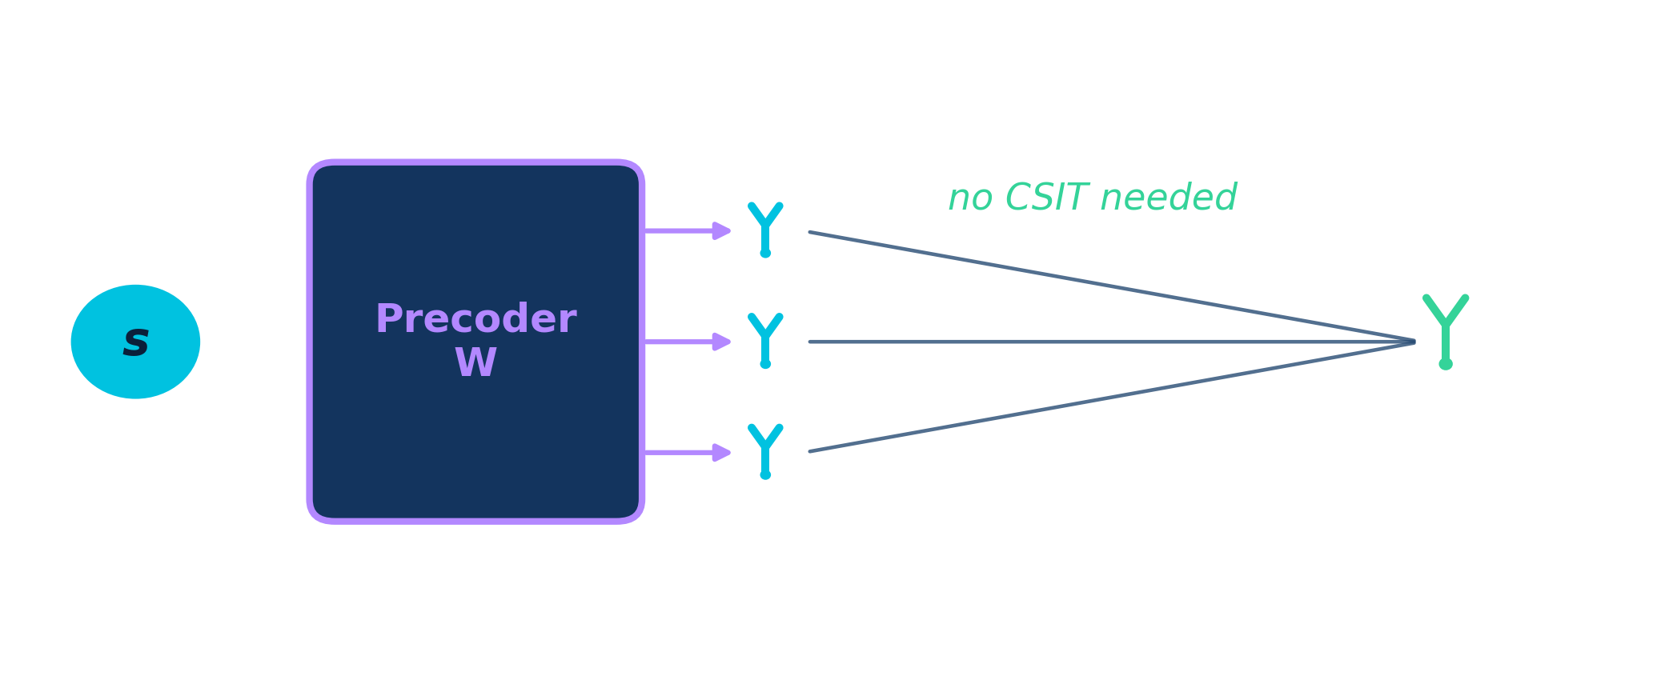
APPROACH 2 · NO CSIT
Precoding-based diversity
Idea
Spread each symbol across antennas with a fixed precoding matrix W — designed once, not adapted to the channel.
Question now becomes: how do we design W (or the code) so diversity is guaranteed?
16

Slide 21
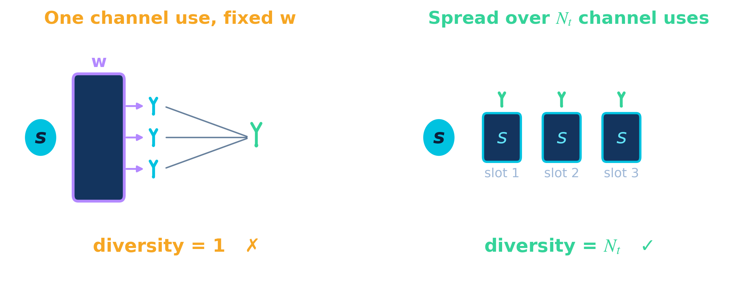
APPROACH 2 · NO CSIT · DESIGN
Designing a full-diversity precoder
A fixed precoder over one channel use gives no diversity — hᴴw is a single fade. With no CSIT you must spread the symbol over Nₜ independent channel uses.
Route A — over time
Route B — over frequency
repetition · delay diversity
cyclic delay diversity (OFDM)
17

Slide 22
NO CSIT · THE IDEA
Adding diversity without channel feedback
▸ The transmitter does not know the channel — no CSIT.
▸ Trick: send the same symbol s from every antenna, shaped by a fixed precoder W.
▸ Each antenna's copy fades differently — if one path is in a deep fade, the others still get through.
The one question
Which W gives the best reliability — with no channel knowledge?
Short answer: spread the symbol equally across all antennas — and the rest follows.
17

Slide 23

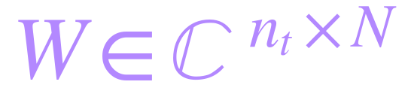

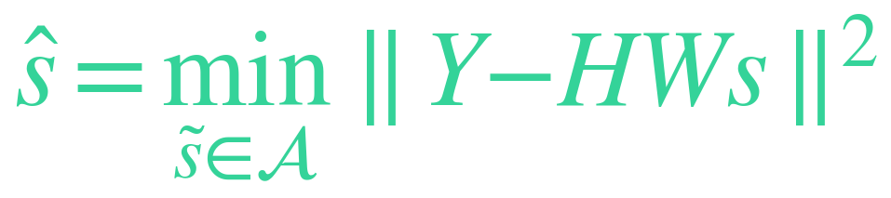
NO CSIT · DERIVATION
Can we increase diversity without CSIT?
Repeat the symbol s over N channel uses — transmit the block X = W·s, with a fixed precoder W (no channel knowledge).
Transmitted block
Precoding matrix
Received signal
ML detection
Question: how should we choose W so that diversity is guaranteed — with no CSIT?
17

Slide 24



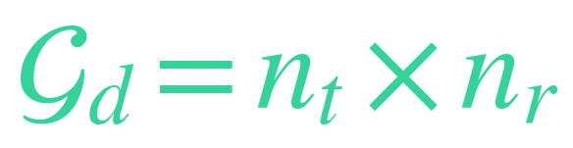
DERIVATION · PEP
From pairwise error probability to diversity
n is the rank of W. If nₜ < N then n = nₜ, so the diversity gain is
full diversity, no CSIT
18

Slide 25


DERIVATION · OPTIMISATION
Designing W to minimise the PEP
Minimise BER (and hence the PEP) under a transmit-power budget:
Maximise the determinant
Equivalently, in the eigenvalues of WWᴴ
with λᵢ the eigenvalues of WWᴴ — a constrained maximisation of their product.
19

Slide 26



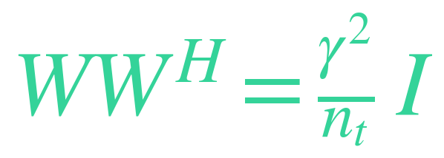
DERIVATION · AM–GM
Maximising the determinant
By the arithmetic–geometric-mean inequality:
Equality holds only when all λᵢ are equal, so:
optimum
20

Slide 27
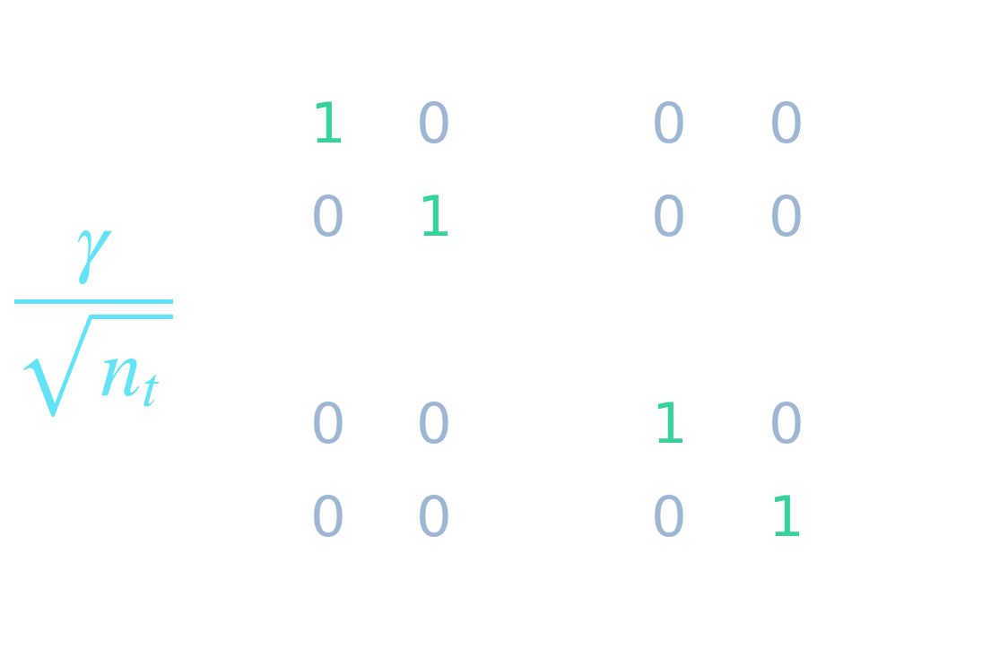
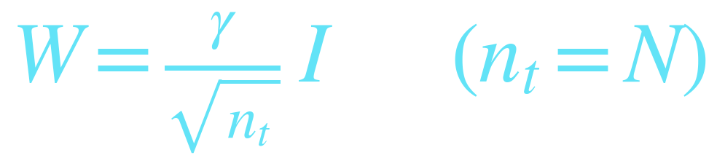

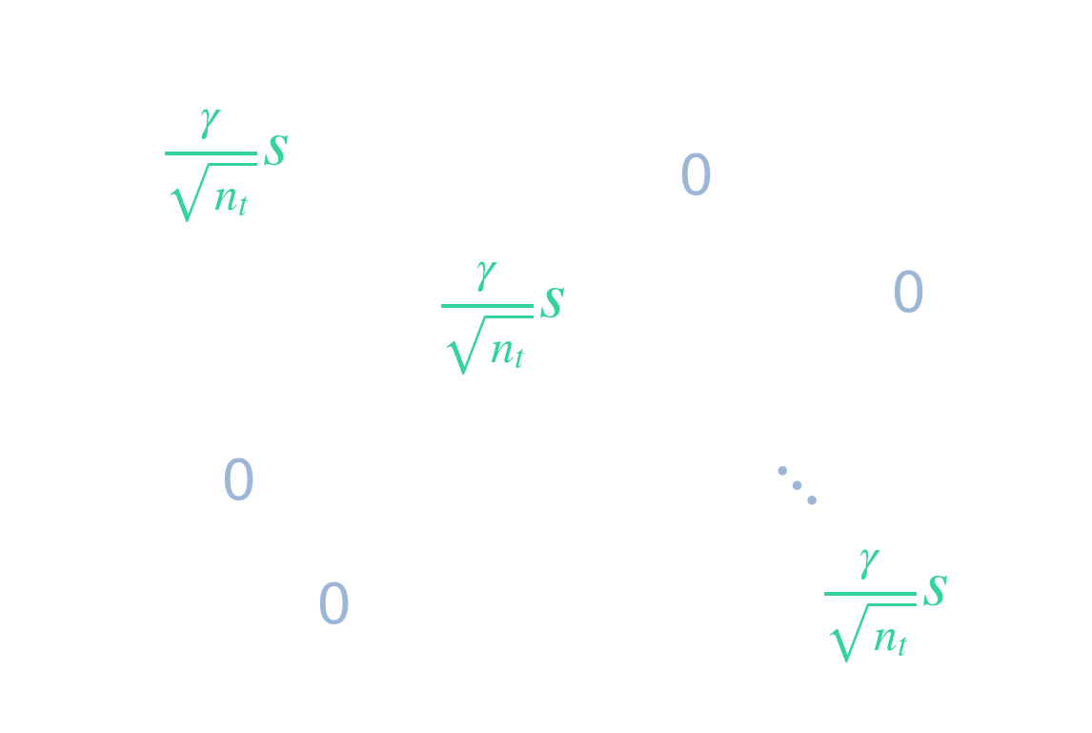
DERIVATION · RESULT
The optimal precoder is scaled-unitary
So W must be proportional to a unitary matrix:
which reduces to a diagonal code:
Only the diagonal survives — exactly one antenna carries s in each time slot.
21

Slide 28
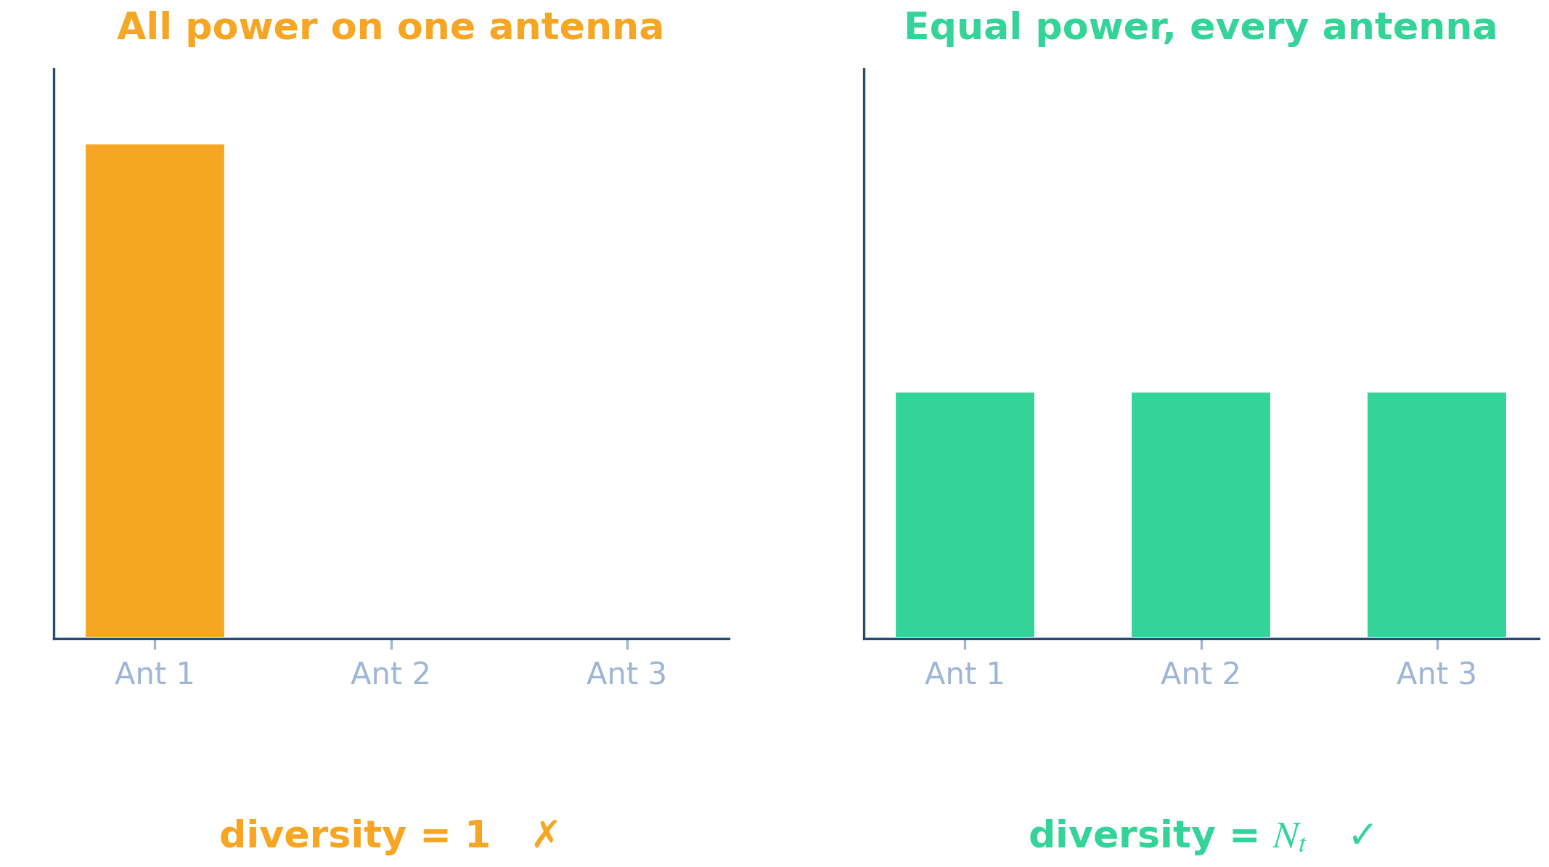
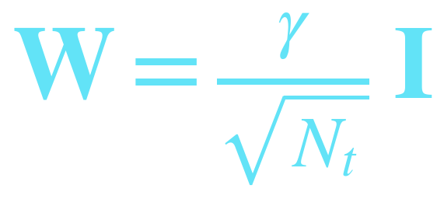
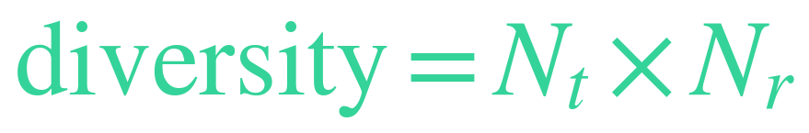

NO CSIT · THE ANSWER
The best precoder spreads energy equally
With no CSIT you can't aim at the channel — so treat every antenna equally. Equal power with orthogonal directions is the fairest, most robust spread.
The best W
a scaled identity (unitary) matrix
Diversity
Rate
18

Slide 29
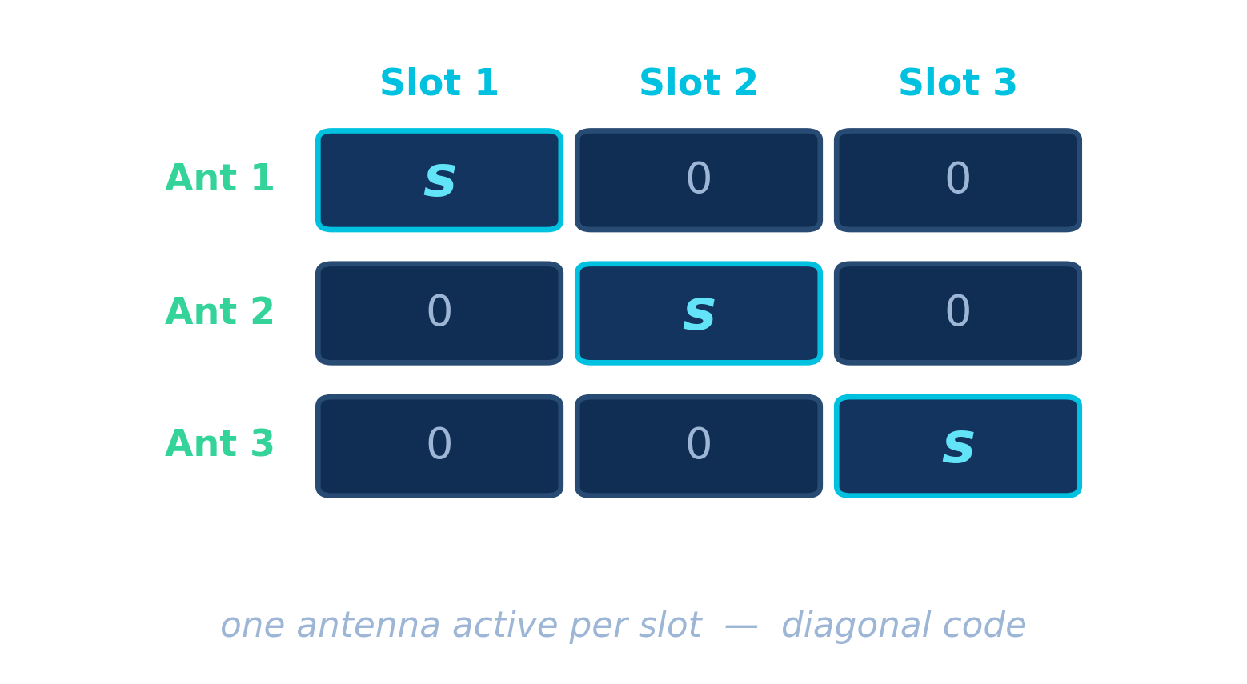
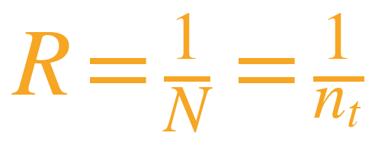
DERIVATION · INTERPRETATION
This precoder = spatial cycling
With this W, symbol s is transmitted in time slot n from antenna n (n = 1 … nₜ); all other antennas stay quiet.
Effective data rate
Diversity gain
Verdict: full diversity nₜ × nᵣ with no CSIT — paid for with rate 1/nₜ. Alamouti later recovers the rate.
22

Slide 30
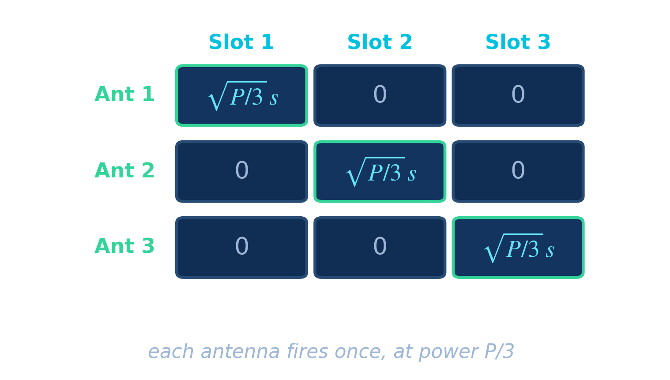
DESIGN EXAMPLE
Design a 3-antenna open-loop scheme
Given: Nₜ = 3 transmit antennas, Nᵣ = 1 receive antenna, total power budget P, no CSIT.
1
Use one time slot per antenna → N = 3
2
Spread equally: W = (1/√3) I₃
3
Send s on the diagonal — each antenna fires once at power P/3
4
Receiver combines the 3 slots (MRC)
Contrast: one antenna only → diversity 1. Equal spread → diversity 3.
RESULT
Diversity
BER slope
Rate
Power / antenna
3 × 1 = 3
3
1/3
P/3
20

Slide 31
CONCEPT CHECK · QUIZ 3
The best blind precoder
?
With no CSIT, the precoder that guarantees full diversity turns out to be …
a channel-matched matrix
a random matrix
A
B
a scaled identity (spatial cycling)
an all-ones matrix
C
D
Answer on the next slide →

Slide 32
ANSWER · QUIZ 3
The best blind precoder
Q: With no CSIT, the precoder that guarantees full diversity turns out to be …
a channel-matched matrix
a random matrix
A
B
✓ correct
a scaled identity (spatial cycling)
an all-ones matrix
C
D
WHY
Equal power + orthogonal directions ⇒ W = (γ/√Nₜ)·I, i.e. spatial cycling: full diversity Nₜ×Nᵣ, but at rate 1/Nₜ.

Slide 33
THE GOAL
Can we have it all?
We want three things at once:
Full diversity
Full rate
Low complexity
best reliability
no loss of throughput
simple decoding
Answer: the Alamouti space-time block code
the first orthogonal STBC — delivers all three for 2 transmit antennas
27

Slide 34
ALAMOUTI SCHEME
A landmark in wireless
Historical note
Properties
Introduced by Siavash Alamouti in 1998 — the first practical space-time block code, now in 3G/4G standards.
▸ Two transmit antennas
▸ Full diversity (order 2 with one RX antenna)
▸ Full data rate — one symbol per channel use
▸ Simple linear decoding, no CSIT
28

Slide 35
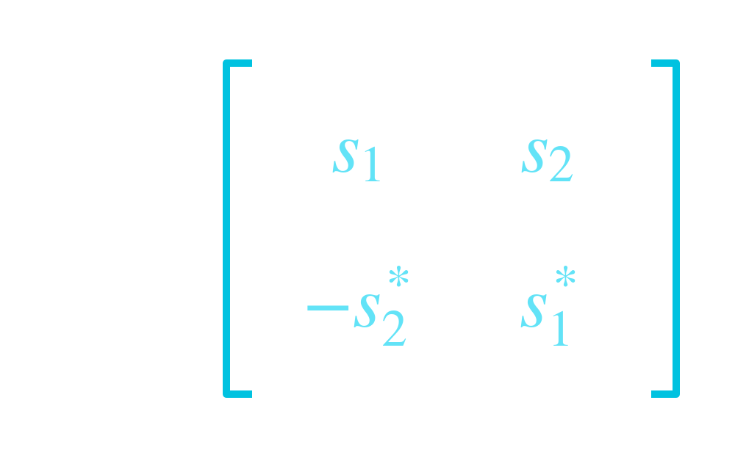
ALAMOUTI SCHEME
The transmission matrix
Read it across two time slots
Slot 1
Antenna 1 → s₁
Antenna 2 → s₂
Slot 2
Antenna 1 → −s₂*
Antenna 2 → s₁*
Columns = antennas, rows = time. (*) = complex conjugate.
29

Slide 36
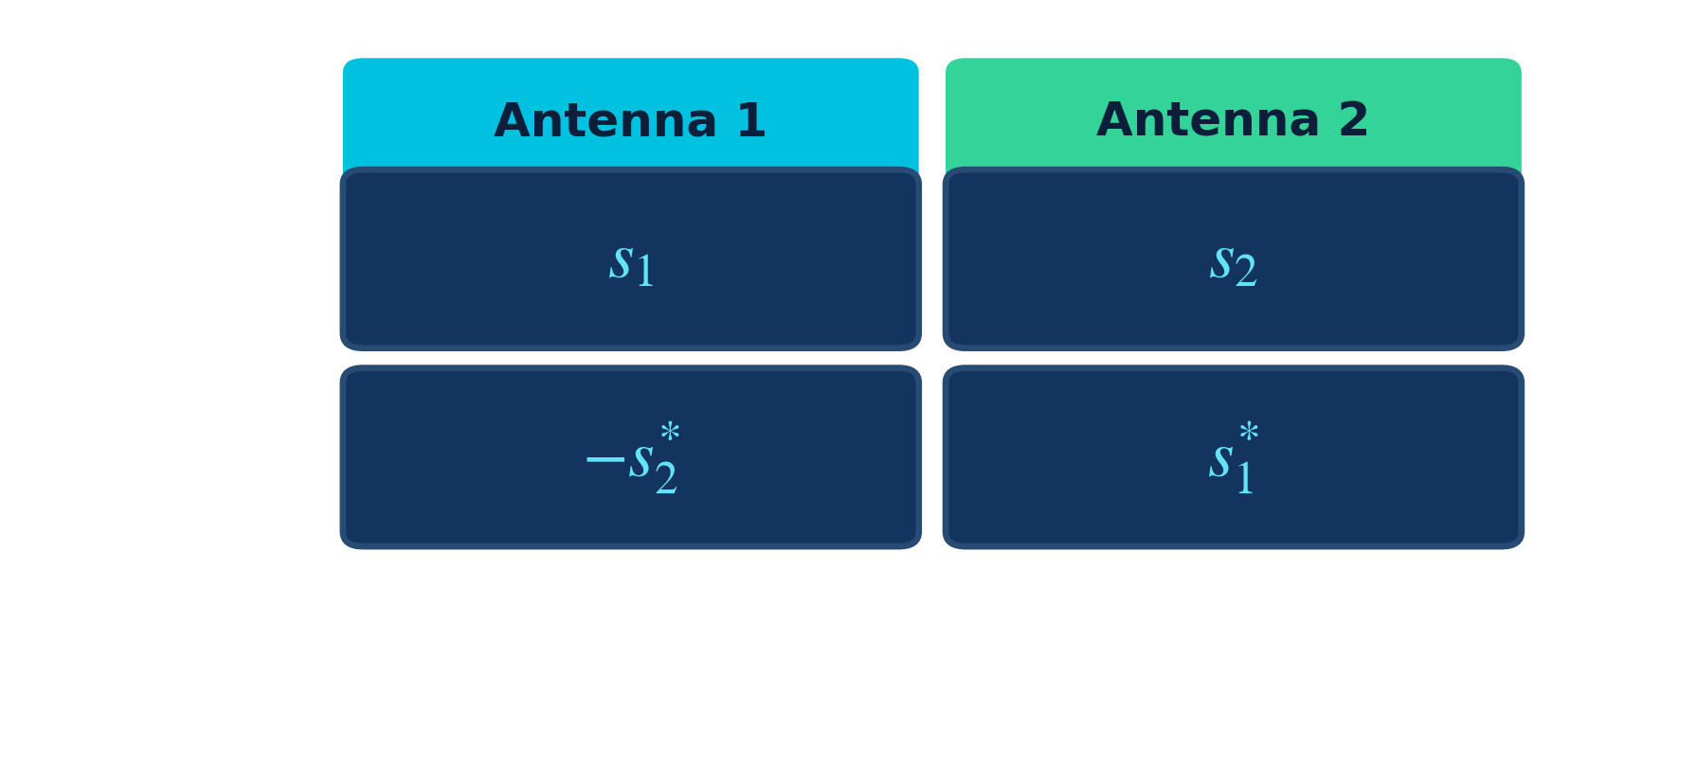
ALAMOUTI SCHEME · EXAMPLE
Two symbols, two time slots
What's happening
▸ Two symbols s₁, s₂ are sent
▸ Spread over 2 antennas × 2 slots
▸ Rate = 2 symbols / 2 slots = 1
▸ Conjugates create orthogonality
30

Slide 37


DERIVATION
Received signals (one RX antenna)
With channel gains h₁, h₂ held constant over the two slots:
r₁ is received in slot 1, r₂ in slot 2 (after conjugation in the model).
31

Slide 38
RECEIVER
Combining the received signals
The receiver applies three simple linear operations:
1
Conjugate
2
Weight
3
Add
take r₂*
multiply by h₁*, h₂
combine the two slots
The cross terms cancel → the two symbols are separated with no interference.
32

Slide 39
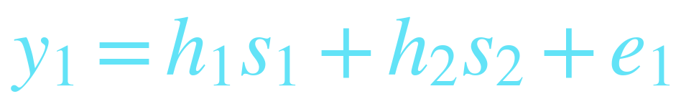
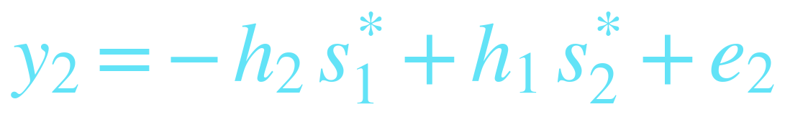
ALAMOUTI RECEIVER · I/O
Received signals: the input–output relation
Over two time slots, with the channel gains h₁, h₂ constant and AWGN e₁, e₂:
Slot 1
Slot 2
Where
h₁, h₂ channel gains s₁, s₂ data symbols e₁, e₂ receiver noise
The conjugates s₁*, s₂* in slot 2 are exactly the Alamouti code in action.
31

Slide 40
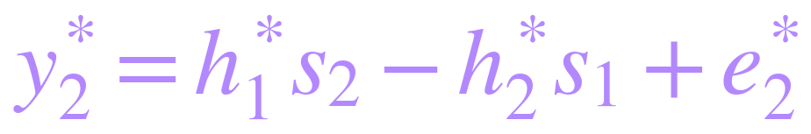


ALAMOUTI RECEIVER · PROCESSING
Signal processing at the receiver
1
Take the conjugate of the slot-2 signal
2
Multiply y₁ by h₁* and y₂* by h₂
Notice: both products now carry the same cross-term h₁*h₂ s₂ — set up to cancel.
32

Slide 41
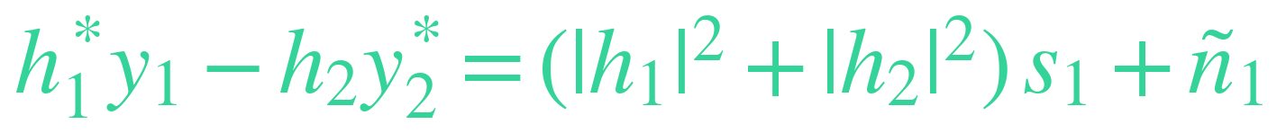
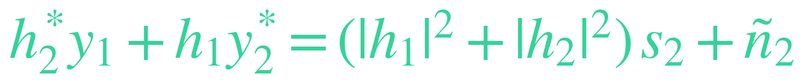
ALAMOUTI RECEIVER · COMBINING
Combining: the interference cancels
Subtract the two products to isolate s₁:
→ the +h₁*h₂ s₂ and −h₁*h₂ s₂ terms cancel (and the s₁ terms add):
Likewise, add the two products to isolate s₂ (the s₁ terms cancel):
Each symbol is now interference-free — only its own signal plus combined noise remains.
33

Slide 42
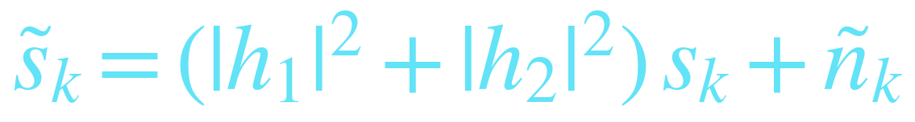
ALAMOUTI RECEIVER · KEY RESULT
The symbols decouple
with the combined noise still white:
Two parallel channels
Effective gain
Noise unchanged
s₁ and s₂ are detected separately
|h₁|²+|h₂|² → diversity order 2
ñₖ is still white Gaussian
34

Slide 43


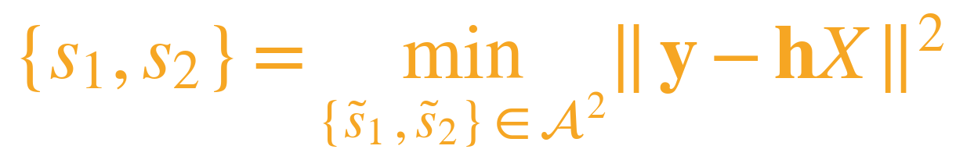
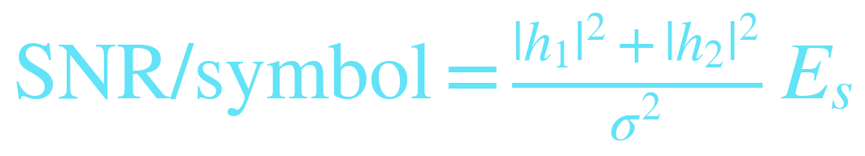
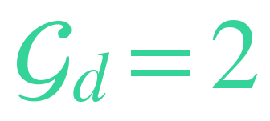
ALAMOUTI RECEIVER · DETECTION
Maximum-likelihood detection
Because the symbols decoupled, ML detection runs on each symbol separately:
Joint ML would cost much more
Received SNR per symbol
→ search 𝒜 instead of 𝒜²
grows with both paths' energy
Alamouti achieves second-order diversity:
full diversity, linear decoding
35

Slide 44
COMPLEXITY
Maximum-likelihood detection
Without decoupling
With Alamouti
Joint search over
M² combinations
Two separate searches over just
M each
For higher-order constellations this is an enormous reduction in receiver complexity.
34

Slide 45
SIMULATION · MATLAB
MATLAB: Alamouti BER simulation
% Alamouti 2x1 vs SISO -- BPSK over Rayleigh fading
SNRdB = 0:2:20; N = 2e5; berA = zeros(size(SNRdB));
for k = 1:numel(SNRdB)
snr = 10^(SNRdB(k)/10); a = sqrt(snr/2); % split power / 2 TX
s1 = 2*(rand(1,N)>.5)-1; s2 = 2*(rand(1,N)>.5)-1;
h1 = (randn(1,N)+1i*randn(1,N))/sqrt(2);
h2 = (randn(1,N)+1i*randn(1,N))/sqrt(2);
n1 = (randn(1,N)+1i*randn(1,N))/sqrt(2);
n2 = (randn(1,N)+1i*randn(1,N))/sqrt(2);
y1 = a*( h1.*s1 + h2.*s2) + n1; % slot 1
y2 = a*(-h2.*conj(s1) + h1.*conj(s2)) + n2; % slot 2
d1 = conj(h1).*y1 - h2.*conj(y2); % decouples s1
d2 = conj(h2).*y1 + h1.*conj(y2); % decouples s2
berA(k) = mean([real(d1)<0 ~= (s1<0), ...
real(d2)<0 ~= (s2<0)]);
end
semilogy(SNRdB, berA, '-s','LineWidth',2); grid on
xlabel('SNR (dB)'); ylabel('BER'); title('Alamouti 2x1')
36

Slide 46
SIMULATION · PYTHON
Python: Alamouti BER simulation
import numpy as np, matplotlib.pyplot as plt
SNRdB = np.arange(0, 21, 2); N = 200_000; berA = []
for snr_db in SNRdB:
snr = 10**(snr_db/10); a = np.sqrt(snr/2) # split power / 2 TX
s1 = 2*(np.random.rand(N) > .5) - 1
s2 = 2*(np.random.rand(N) > .5) - 1
h1 = (np.random.randn(N)+1j*np.random.randn(N))/np.sqrt(2)
h2 = (np.random.randn(N)+1j*np.random.randn(N))/np.sqrt(2)
n1 = (np.random.randn(N)+1j*np.random.randn(N))/np.sqrt(2)
n2 = (np.random.randn(N)+1j*np.random.randn(N))/np.sqrt(2)
y1 = a*( h1*s1 + h2*s2) + n1 # slot 1
y2 = a*(-h2*s1.conj() + h1*s2.conj()) + n2 # slot 2
d1 = h1.conj()*y1 - h2*y2.conj() # decouples s1
d2 = h2.conj()*y1 + h1*y2.conj() # decouples s2
berA.append(np.mean([(d1.real<0)!=(s1<0),
(d2.real<0)!=(s2<0)]))
plt.semilogy(SNRdB, berA, '-s'); plt.grid(True)
plt.xlabel('SNR (dB)'); plt.ylabel('BER')
37

Slide 47
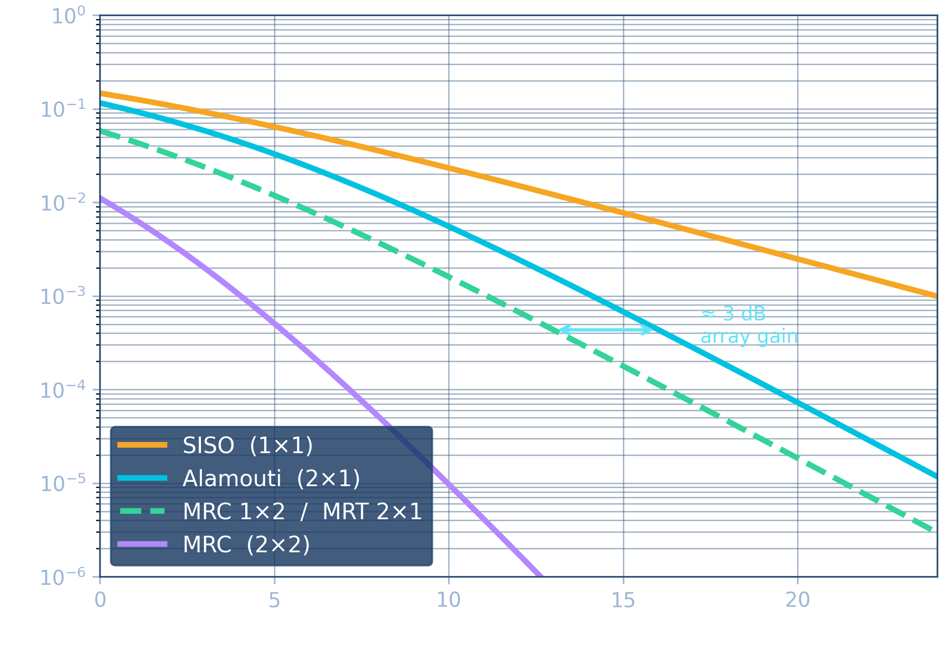
SIMULATION · RESULTS
BER: Alamouti vs other schemes
Reading the curves
SISO
slope 1 — no diversity
Alamouti 2×1
slope 2 — full diversity, no CSIT
MRC 1×2 / MRT 2×1
slope 2, but ~3 dB better
MRC 2×2
slope 4 — steepest
Alamouti = MRC-1×2 slope, paid for with 3 dB (no array gain).
38

Slide 48
DESIGN PROBLEM · ALAMOUTI
Design a 2×1 Alamouti downlink
Scenario: a base station with 2 transmit antennas serves a single-antenna handset at the cell edge using Alamouti diversity. Modulation QPSK, Rayleigh fading, total transmit power P, noise σ².
Given: channel snapshot h₁ = 1+j , h₂ = 1+2j symbols to send s₁ = (1+j)/√2 , s₂ = (1−j)/√2
Tasks
1
Write the transmission table — what does each antenna send, in each slot?
2
Find the power transmitted per antenna.
3
Given the received signals y₁, y₂, recover s₁ and s₂.
4
What diversity order is achieved, and what is the SNR advantage over SISO at BER = 10⁻³?
45

Slide 49
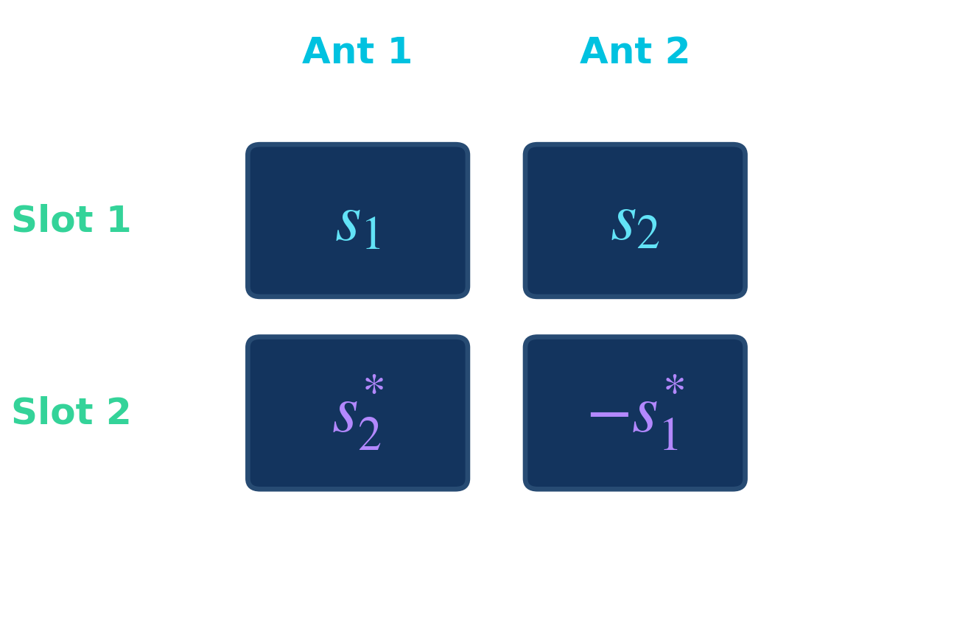
SOLUTION · STEP 1
Transmission design
The Alamouti block over 2 slots:
▸ Slot 1: antenna 1 sends s₁, antenna 2 sends s₂.
▸ Slot 2: antenna 1 sends s₂*, antenna 2 sends −s₁*.
▸ Both antennas are active every slot — split the budget: P/2 per antenna per slot (total P).
▸ 2 symbols delivered in 2 slots → rate 1, no rate loss versus SISO.
Per antenna: P/2, each symbol carried twice across the two slots.
46

Slide 50
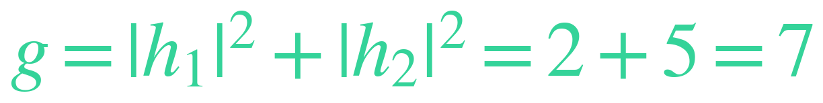
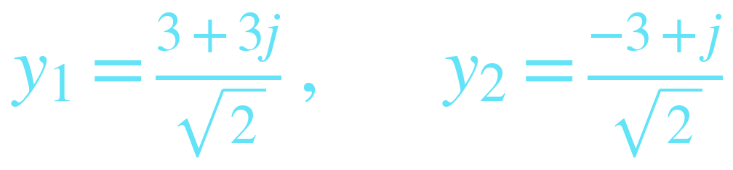
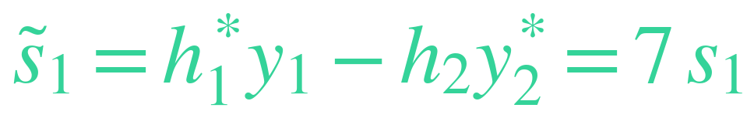
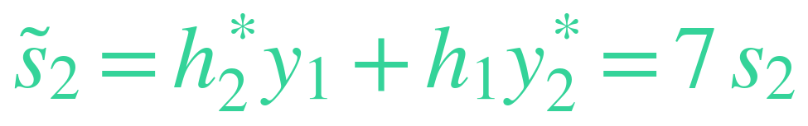
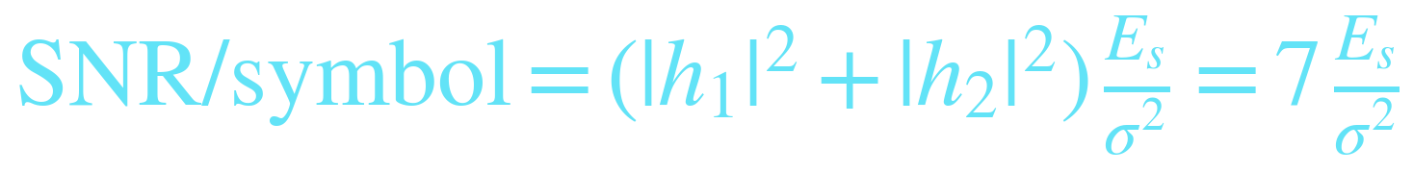

SOLUTION · STEP 2
Receiver processing & recovery
Effective gain
Received (this snapshot)
Combine for s₁
Combine for s₂
SNR per symbol
symbols decouple → exact recovery
47

Slide 51
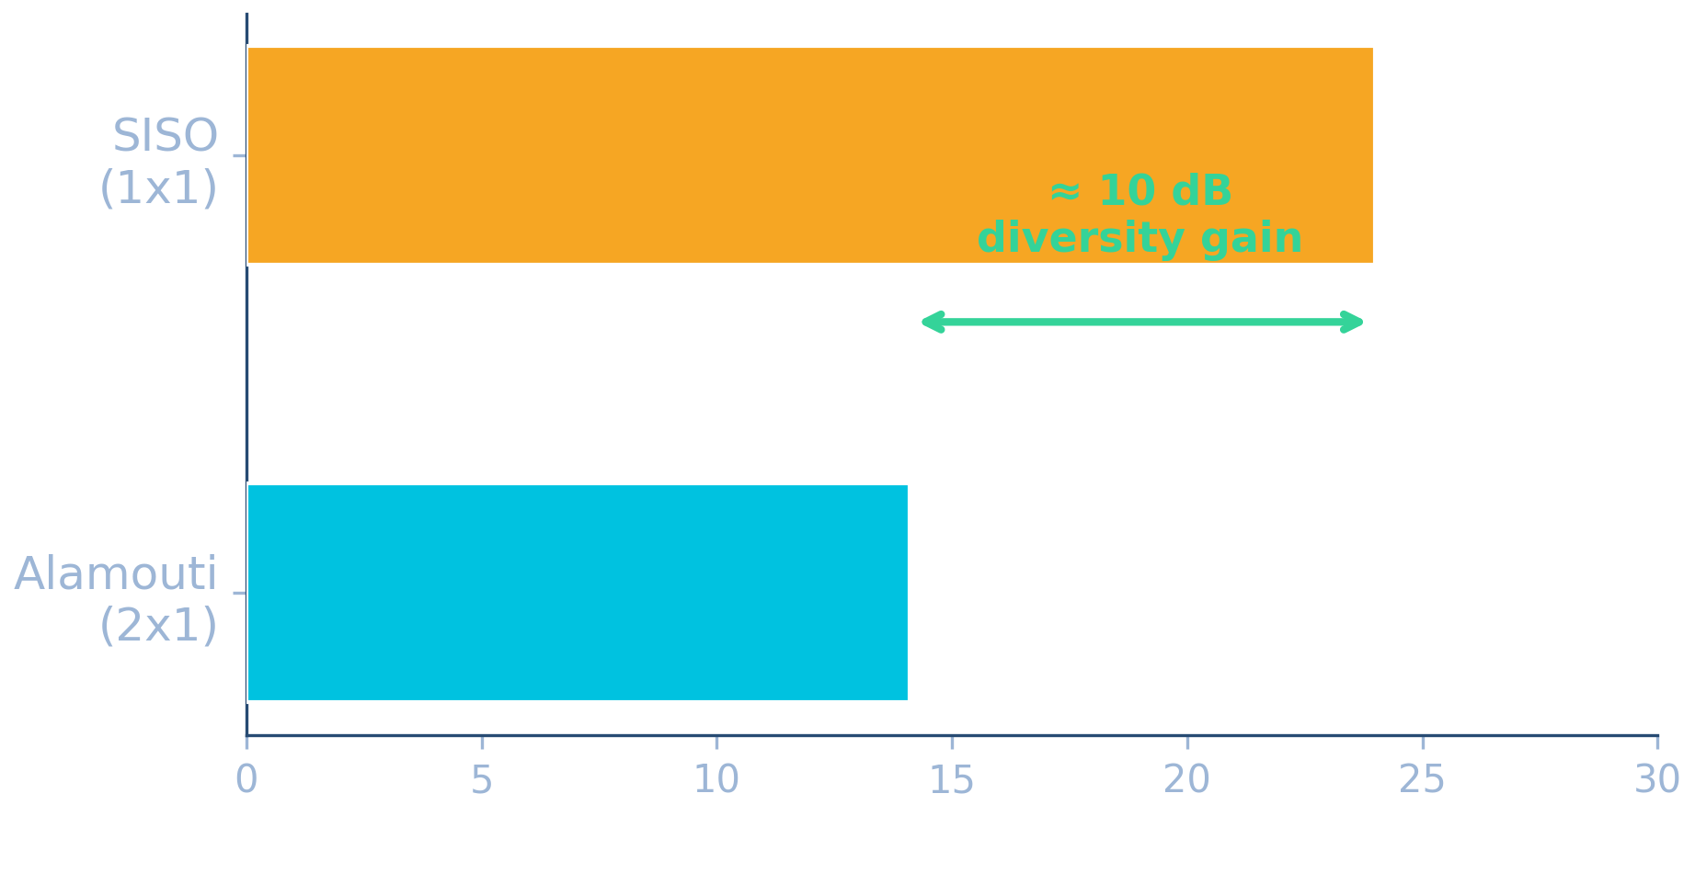
SOLUTION · STEP 3
Performance & link budget
What we bought
▸ Diversity order = Nₜ × Nᵣ = 2 × 1 = 2.
▸ BER 10⁻³ needs ≈ 24 dB for SISO, but only ≈ 14 dB with Alamouti.
▸ → about 10 dB saved at the cell edge.
▸ Same rate as SISO, and no CSIT required.
Verdict: a second transmit antenna and Alamouti coding buy ~10 dB at BER 10⁻³ — full diversity, rate 1, linear decoding, no feedback. That margin is the difference between a dropped and a held call at the edge.
48

Slide 52
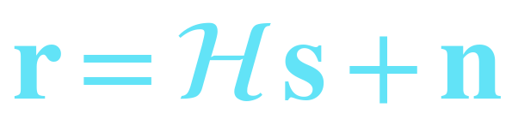
COMPACT VIEW
Matrix form of the Alamouti code
Stack the two time slots into one linear system:
r
ℋ
s
n
received vector
equivalent channel
symbol vector
noise vector
35

Slide 53
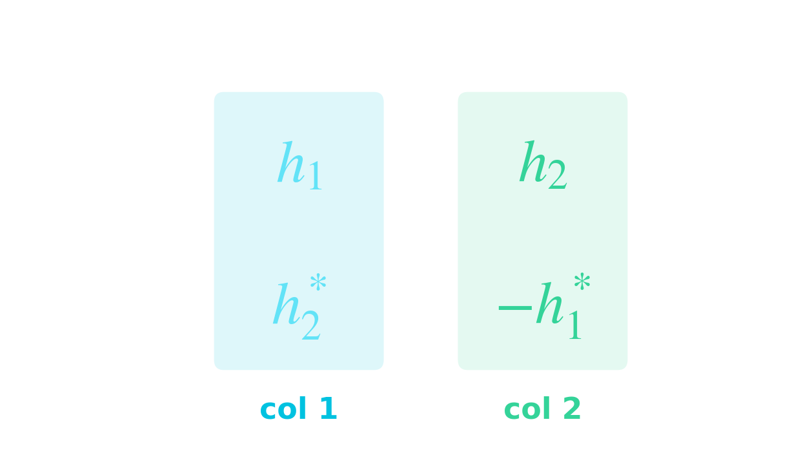
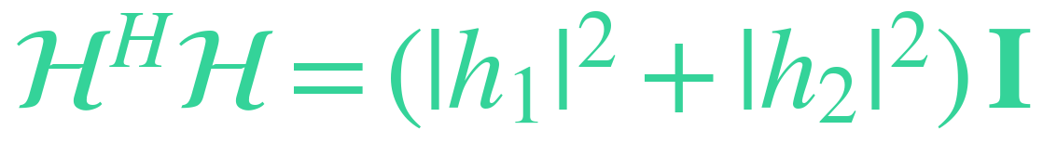
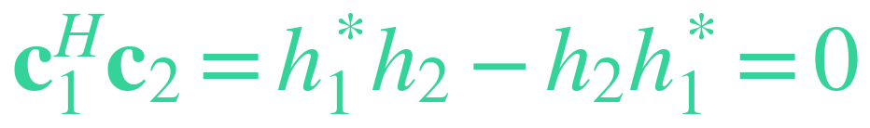
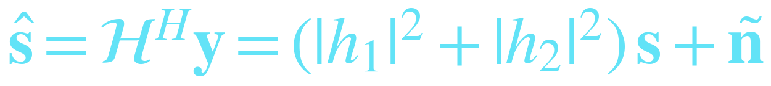
WHY IT WORKS
The orthogonality property
Stack the two slots: r = ℋ s + n
The orthogonality identity
Because the columns are orthogonal and equal-norm, ℋᴴℋ collapses to a scaled identity — every cross (interference) term is exactly zero.
The two columns are orthogonal
Matched-filter decode
apply ℋᴴ to y
Parallel channels
No interference
Full diversity
the 2×2 link splits into two independent scalar channels
symbols decouple — detect s₁ and s₂ separately
each symbol sees gain |h₁|²+|h₂|², diversity order 2
36

Slide 54
CONCEPT CHECK · QUIZ 4
Why decoding stays simple
?
Why can the Alamouti receiver detect s₁ and s₂ one at a time with simple linear processing?
Because there is no noise
Because the equivalent-channel columns are orthogonal
A
B
Because the transmitter knows the channel
Because only one antenna is used
C
D
Answer on the next slide →

Slide 55
ANSWER · QUIZ 4
Why decoding stays simple
Q: Why can the Alamouti receiver detect s₁ and s₂ one at a time with simple linear processing?
Because there is no noise
✓ correct
Because the equivalent-channel columns are orthogonal
A
B
Because the transmitter knows the channel
Because only one antenna is used
C
D
WHY
Orthogonal columns make ℋᴴℋ a scaled identity, so the two symbols decouple — no joint search is needed.

Slide 56




WORKED EXAMPLE · ALAMOUTI
Decode an Alamouti block — by the numbers
Given: h₁ = 1+j , h₂ = 1−j (single receive antenna)
1
Effective gain
2
Orthogonal equivalent channel
3
Decode
RESULT
Both symbols are recovered with no interference, SNR scaled ×4 (6 dB) and diversity order 2.
37

Slide 57




WHY IT WORKS · SNR
The SNR after combining
From the matched filter: ŝ = a s + ñ
Post-combining SNR
Signal power grows as a², noise only as a — so one factor of a = |h₁|²+|h₂|² survives as SNR. A deep fade now has to hit both channels at once to hurt you.
Noise after the matched filter
Compare the contenders
same total power P
Diversity 2
No array gain
Average SNR unchanged
two independent |hᵢ|² terms in γ — the BER curve falls with slope 2
the P/2 power split leaves Alamouti exactly 3 dB behind MRC 1×2
E[γ] = P/σ², same as SISO — what shrinks is the fading variance

Slide 58

BEYOND ALAMOUTI
Why two antennas is special
Alamouti is an orthogonal STBC — orthogonality buys full diversity and simple linear decoding. But for complex symbols that gift only extends so far.
The result (complex constellations)
Nt = 2
rate 1 — full
Alamouti, the only one
Nt = 3, 4
rate 3/4
unavoidable rate loss
any Nt
rate 1/2
always exists
→ Alamouti uniquely gives full rate + full diversity.
For more antennas
relax one goal:
Quasi-orthogonal STBC
Spatial multiplexing
CSIT precoding
more rate, slight interference
max rate, no built-in diversity
use feedback (SVD / water-filling)
38

Slide 59


PERFORMANCE
Diversity order of Alamouti
Special case (Nt = 2, Nr = 1)
diversity order = 2
General case
Same diversity slope as MRT — without any CSIT.
39

Slide 60
CONCEPT CHECK · QUIZ 5
Count the diversity
?
An Alamouti system with 2 transmit and 2 receive antennas achieves what diversity order?
1
2
A
B
3
4
C
D
Answer on the next slide →

Slide 61
ANSWER · QUIZ 5
Count the diversity
Q: An Alamouti system with 2 transmit and 2 receive antennas achieves what diversity order?
1
2
A
B
3
✓ correct
4
C
D
WHY
Diversity order = Nₜ × Nᵣ = 2 × 2 = 4 (equivalently 2Nᵣ). At high SNR the BER curve falls with a slope of 4.

Slide 62
SUMMARY
Why Alamouti is special
✓
✓
✓
✓
✓
Full diversity
Full rate
No CSIT
Simple ML
Orthogonal STBC
order 2Nr
1 symbol / use
blind at the TX
linear, decoupled
clean structure
Diversity gain with the simplicity of an open-loop scheme — that is its lasting impact.
40

Slide 63
COMPARISON
Beamforming vs Alamouti
Feature
Beamforming (MRT)
Alamouti
CSIT required
Yes
No
Diversity gain
Full
Full
Array gain
Yes
No
Complexity
Moderate
Low
Feedback
Needed
None
Implementation
Harder
Simple
Same diversity, different cost: closed-loop SNR boost vs open-loop simplicity.
41

Slide 64
CONCEPT CHECK · QUIZ 6
Pick a diversity scheme
?
A receiver is moving fast and reliable channel feedback to the transmitter is unavailable. Which transmit-diversity scheme fits best?
MRT beamforming
Alamouti STBC
A
B
Single antenna (SISO)
SVD precoding + water-filling
C
D
Answer on the next slide →
42

Slide 65
ANSWER · QUIZ 1
Why Alamouti fits here
Q: A receiver is moving fast and reliable channel feedback to the transmitter is unavailable. Which transmit-diversity scheme fits best?
MRT beamforming
✓ correct
Alamouti STBC
A
B
Single antenna (SISO)
SVD precoding + water-filling
C
D
WHY
Alamouti is open-loop — no CSIT needed — yet it gives full diversity, full rate and simple linear decoding. MRT (A) and SVD precoding (D) both need channel knowledge / feedback at the transmitter; SISO (C) provides no diversity at all.
43

Slide 66

BEYOND ALAMOUTI · OSTBC
Generalising to more antennas
Alamouti is the unique rate-1, full-diversity, linearly-decodable complex code for 2 antennas. The generalisation is the Orthogonal STBC (OSTBC) — an Nₜ-antenna code matrix 𝒢(s) whose columns stay orthogonal:
▸ Orthogonality ⇒ the symbols decouple — single-symbol linear ML decoding (as in Alamouti).
▸ Full diversity Nₜ × Nᵣ is automatic (every symbol-difference matrix is full rank).
▸ So the goal for Nₜ = 3, 4, … is to keep this orthogonality. Can we — at full rate?
46

Slide 67

OSTBC · EXAMPLE
A rate-3/4 code for 3 antennas
3 symbols (s₁, s₂, s₃) over 4 time slots:
▸ Rate = 3 symbols / 4 slots = 3/4.
▸ Columns are orthogonal ⇒ 𝒢ᴴ𝒢 = (|s₁|²+|s₂|²+|s₃|²) I.
▸ Full diversity 3 × Nᵣ — every symbol-difference is full rank.
▸ Still single-symbol linear ML decoding, just like Alamouti.
▸ A rate-3/4 design for 4 antennas follows the same pattern.
Trade-off: orthogonality and full diversity are kept — but the rate has dropped from 1 to 3/4.
48

Slide 68

OSTBC · EXAMPLE
A rate-3/4 code for 4 antennas
3 symbols (s₁, s₂, s₃) over 4 slots:
▸ Rate = 3/4 (same as the 3-antenna code).
▸ Orthogonal ⇒ 𝒢ᴴ𝒢 = (|s₁|²+|s₂|²+|s₃|²) I.
▸ Full diversity 4 × Nᵣ.
▸ Still single-symbol linear ML decoding.
▸ Needs √2 scaling and Re/Im combinations — less clean than 3 antennas.
Same trade-off: orthogonality and full diversity for 4 antennas, at rate 3/4 — the extra antenna costs a busier code.
49

Slide 69

OSTBC · EXAMPLE
A rate-1/2 code for 3 antennas
4 symbols (s₁…s₄) over 8 time slots:
▸ Rate = 4 symbols / 8 slots = 1/2.
▸ Built by stacking a design and its conjugate — all entries are just symbols and conjugates (no scaling, no combinations).
▸ Orthogonal ⇒ full diversity 3 × Nᵣ, single-symbol linear decoding.
▸ The simplest full-diversity complex code — the price is the low rate.
Why use it: cleanest possible construction and it exists for any Nₜ — trade rate for simplicity.
50

Slide 70

OSTBC · EXAMPLE
A rate-1/2 code for 4 antennas
4 symbols (s₁…s₄) over 8 time slots:
▸ Rate = 4 / 8 = 1/2.
▸ Same stack-and-conjugate recipe as the 3-antenna code, now with a 4th column.
▸ Orthogonal ⇒ 𝒢ᴴ𝒢 = 2(Σ|sₖ|²) I ⇒ full diversity 4 × Nᵣ.
▸ Single-symbol linear ML decoding throughout.
Rate ladder for 4 antennas: rate 1/2 (clean, this slide) → rate 3/4 (busier H₄). Higher rate always costs code complexity.
51

Slide 71
OSTBC · CATALOG
Standard complex OSTBC designs
Antennas
Code
Slots
Symbols
Rate
Diversity
2
Alamouti
2
2
1
full · 2Nᵣ
3
rate-3/4
4
3
3/4
full · 3Nᵣ
4
rate-3/4 (H₄)
4
3
3/4
full · 4Nᵣ
3
rate-1/2 (G₃)
8
4
1/2
full · 3Nᵣ
4
rate-1/2 (G₄)
8
4
1/2
full · 4Nᵣ
All of them: orthogonal columns ⇒ full diversity and single-symbol linear decoding.
The pattern: complex OSTBCs give rate 1 only at Nₜ = 2 (Alamouti). For 3–4 antennas the best is rate 3/4; rate 1/2 is the clean fallback for any Nₜ.
52

Slide 72


OSTBC · THE RATE LIMIT
The rate limit of complex OSTBCs
Key result: a full-rate (rate-1) complex orthogonal design exists only for Nₜ = 2. Beyond that, the rate must drop:
Maximal-rate formula
(Liang, 2003)
Rate by antenna count
▸ Nₜ = 2 → rate 1 (Alamouti)
▸ Nₜ = 3, 4 → 3/4
▸ Nₜ = 5, 6 → 2/3
▸ Nₜ = 7, 8 → 5/8
Note: real OSTBCs (PAM) reach rate 1 for Nₜ = 2, 4, 8 — but complex constellations only at Nₜ = 2.
47

Slide 73
SIMULATION · MATLAB
MATLAB: comparing complex OSTBCs
% Complex OSTBC comparison -- QPSK over Rayleigh fading, one RX antenna
% Orthogonality => exact equivalent scalar channel: gamma = a*(snr/Nt)*||h||^2
schemes = { 'Alamouti 2Tx, rate 1',2,1; 'OSTBC 3Tx, rate 3/4',3,1;
'OSTBC 4Tx, rate 3/4',4,1; 'OSTBC 4Tx, rate 1/2',4,2 }; % {name,Nt,a}
SNRdB = 0:2:20; N = 2e5; ber = zeros(4,numel(SNRdB));
for m = 1:4
Nt = schemes{m,2}; a = schemes{m,3};
for k = 1:numel(SNRdB)
snr = 10^(SNRdB(k)/10);
h = (randn(N,Nt)+1i*randn(N,Nt))/sqrt(2);
g = a*snr/Nt .* sum(abs(h).^2,2); % post-combining SNR
s = ((2*(rand(N,1)>.5)-1)+1i*(2*(rand(N,1)>.5)-1))/sqrt(2); % QPSK
n = (randn(N,1)+1i*randn(N,1))/sqrt(2);
y = sqrt(g).*s + n; % decoupled symbol channel
ber(m,k) = mean([real(y)<0 ~= (real(s)<0); imag(y)<0 ~= (imag(s)<0)]);
end
end
semilogy(SNRdB,ber,'-s','LineWidth',2); grid on; legend(schemes{:,1})
xlabel('SNR (dB)'); ylabel('BER'); title('Complex OSTBC comparison')

Slide 74
SIMULATION · PYTHON
Python: comparing complex OSTBCs
import numpy as np, matplotlib.pyplot as plt
# Complex OSTBC comparison -- QPSK over Rayleigh fading, one RX antenna
# Orthogonality => exact equivalent scalar channel: gamma = a*(snr/Nt)*||h||^2
schemes = [('Alamouti 2Tx, rate 1',2,1), ('OSTBC 3Tx, rate 3/4',3,1),
('OSTBC 4Tx, rate 3/4',4,1), ('OSTBC 4Tx, rate 1/2',4,2)] # (name,Nt,a)
SNRdB = np.arange(0, 21, 2); N = 200_000
for name, Nt, a in schemes:
ber = []
for snr_db in SNRdB:
snr = 10**(snr_db/10)
h = (np.random.randn(N,Nt)+1j*np.random.randn(N,Nt))/np.sqrt(2)
g = a*snr/Nt * np.sum(np.abs(h)**2, axis=1) # post-combining SNR
s = ((2*(np.random.rand(N)>.5)-1)+1j*(2*(np.random.rand(N)>.5)-1))/np.sqrt(2)
n = (np.random.randn(N)+1j*np.random.randn(N))/np.sqrt(2)
y = np.sqrt(g)*s + n # decoupled symbol channel
ber.append(np.mean([(y.real<0)!=(s.real<0), (y.imag<0)!=(s.imag<0)]))
plt.semilogy(SNRdB, ber, '-s', label=name)
plt.legend(); plt.grid(True)
plt.xlabel('SNR (dB)'); plt.ylabel('BER'); plt.title('Complex OSTBC comparison')

Slide 75

SIMULATION · RESULTS
BER: comparing complex OSTBCs
Reading the curves
SISO (1 Tx)
slope 1 — the no-diversity reference
Alamouti 2 Tx · rate 1
slope 2 — full diversity at full rate
OSTBC 3 Tx · rate 3/4
slope 3 — one more antenna, steeper fall
OSTBC 4 Tx · 3/4 & 1/2
both slope 4 — parallel curves, 3 dB apart
Antennas set the slope; the code sets the shift — rate-1/2 G₄ collects 2× energy per symbol (+3 dB).

Slide 76
SIMULATION · INTERPRETATION 1
What the slopes are telling us
Reading the plot at BER = 10⁻³
▸ Slope = diversity order: SISO 1, Alamouti 2, the 3 Tx code 3, both 4 Tx codes 4 — full Nₜ × Nᵣ every time.
▸ SISO needs ≈ 27 dB; Alamouti reaches it at ≈ 17 dB — the first extra antenna buys ~10 dB.
▸ 3 Tx rate-3/4 ≈ 14.4 dB, 4 Tx rate-3/4 ≈ 13.1 dB — gains of ~2.7 dB, then ~1.3 dB: diminishing returns.
▸ The 4 Tx curves are parallel, exactly 3 dB apart: G₄ sends each symbol twice (𝒢ᴴ𝒢 = 2Σ|sₖ|²I) — energy gain, no slope change.
Verdict: diversity order sets the slope and dominates at high SNR; energy per symbol only slides the curve sideways. The first antennas are worth the most — beyond four, every extra dB gets expensive.

Slide 77

SIMULATION · INTERPRETATION 2
What the plot hides: the rate axis
Same power ≠ same throughput
▸ All five curves use QPSK at equal transmit power — so throughput differs: Alamouti delivers 2 b/s/Hz, the rate-3/4 codes 1.5, and G₄ only 1.
▸ At fixed spectral efficiency the rate loss must be repaid with a bigger constellation — G₄ needs 16-QAM to match Alamouti's 2 b/s/Hz — costing several dB and eating into its 3 dB head start.
▸ The diversity slope survives any fair comparison; the dB gaps between curves do not — always re-rank the schemes at the spectral efficiency you actually need.
Bottom line: 2 antennas → Alamouti, always. Beyond that: rate-3/4 when throughput matters, rate-1/2 when raw reliability at low rate is the mission — and re-check the ranking at equal b/s/Hz before committing.

Slide 78

BEYOND OSTBC · QOSTBC
Quasi-orthogonal STBC: back to rate 1
The rate penalty hurts. Quasi-orthogonal STBCs (Jafarkhani, 2001) relax full orthogonality to win back rate 1 for 4 antennas.
Built from two Alamouti blocks (ABBA)
X = [ A₁₂ A₃₄ ; −A₃₄* A₁₂* ]
each Aᵢⱼ is a 2×2 Alamouti block — so 4 symbols ride in one 4×4 matrix (rate 1).
49

Slide 79

QOSTBC · DECODING & DIVERSITY
Pairwise decoding and the rotation fix
The columns are orthogonal in pairs, not fully — so the symbols decouple into two pairs, not singletons:
▸ Decoding is pairwise: jointly search |𝒜|² per pair, not |𝒜|⁴ — cheaper than full ML, dearer than OSTBC.
▸ The catch: plain QOSTBC does NOT reach full diversity (some symbol differences give zero coding gain).
▸ Fix: rotate one pair's constellation (s₃, s₄) by an optimised angle → full diversity 4Nᵣ restored, still rate 1.
Net: QOSTBC buys rate 1 for 4 antennas — paid for with pairwise (not single-symbol) decoding and a constellation rotation.
50

Slide 80
QOSTBC · SIMULATION · MATLAB
MATLAB: QOSTBC vs OSTBC at equal rate
% QOSTBC (ABBA, 4 Tx, rate 1, QPSK) vs OSTBC G4 (4 Tx, rate 1/2, 16-QAM): both 2 b/s/Hz
% Equivalent model y = a*H*s + n; H'*H = ||h||^2*I + beta*P => ML pairs (s1,s4),(s2,s3)
QP = [1+1i 1-1i -1+1i -1-1i]/sqrt(2); cj = @conj; SNRdB = 0:2:20; N = 2e5; ber = zeros(2,11);
rot = exp(1i*pi/4); % rotation on s3,s4 restores full diversity; rot = 1 -> slope 2
for k = 1:numel(SNRdB)
snr = 10^(SNRdB(k)/10); amp = sqrt(snr/4);
h = (randn(N,4)+1i*randn(N,4))/sqrt(2); s = QP(randi(4,N,4)); s(:,3:4) = rot*s(:,3:4);
h1 = h(:,1); h2 = h(:,2); h3 = h(:,3); h4 = h(:,4);
Y = amp*[sum(h.*s,2), cj(h2).*s(:,1)-cj(h1).*s(:,2)+cj(h4).*s(:,3)-cj(h3).*s(:,4), ...
cj(h3).*s(:,1)+cj(h4).*s(:,2)-cj(h1).*s(:,3)-cj(h2).*s(:,4), ...
h4.*s(:,1)-h3.*s(:,2)-h2.*s(:,3)+h1.*s(:,4)] + (randn(N,4)+1i*randn(N,4))/sqrt(2);
z = [cj(h1).*Y(:,1)+h2.*Y(:,2)+h3.*Y(:,3)+cj(h4).*Y(:,4), ... % matched filter H'Y
cj(h2).*Y(:,1)-h1.*Y(:,2)+h4.*Y(:,3)-cj(h3).*Y(:,4), ...
cj(h3).*Y(:,1)+h4.*Y(:,2)-h1.*Y(:,3)-cj(h2).*Y(:,4), ...
cj(h4).*Y(:,1)-h3.*Y(:,2)-h2.*Y(:,3)+cj(h1).*Y(:,4)];
beta = 2*real(cj(h1).*h4 - h2.*cj(h3)); errs = 0; P = [1 4 1; 2 3 -1];
for p = 1:2, i = P(p,1); j = P(p,2); sg = P(p,3); M = inf(N,1); D = zeros(N,2);
for c1 = QP, for c2 = rot*QP % 16-pair ML; |c| = 1: a-term constant
m = sg*2*amp*beta*real(cj(c1)*c2) - 2*real(cj(z(:,i))*c1 + cj(z(:,j))*c2);
w = m < M; M(w) = m(w); D(w,1) = c1; D(w,2) = c2;
end, end
t = [s(:,i), s(:,j)/rot]; D(:,2) = D(:,2)/rot;
errs = errs + sum(sum((real(D)<0) ~= (real(t)<0))) + sum(sum((imag(D)<0) ~= (imag(t)<0)));
end, ber(1,k) = errs/(8*N); % 8 bits per 4-slot block
g = 2*snr/4*sum(abs((randn(N,4)+1i*randn(N,4))/sqrt(2)).^2, 2); % OSTBC G4: scalar channel
lv = [-3 -1 1 3]/sqrt(10); GR = [0 1 3 2]; ii = randi(4,N,1); qq = randi(4,N,1);
y = (sqrt(g).*(lv(ii)+1i*lv(qq)) + (randn(N,1)+1i*randn(N,1))/sqrt(2))./sqrt(g);
di = min(max(round((real(y)*sqrt(10)+3)/2),0),3)+1; dq = min(max(round((imag(y)*sqrt(10)+3)/2),0),3)+1;
e = bitxor(GR(ii),GR(di)) + 4*bitxor(GR(qq),GR(dq)); nb = 0; % Gray 16-QAM bit errors
for b = 0:3, nb = nb + sum(bitand(floor(e/2^b),1)); end, ber(2,k) = nb/(4*N);
end
semilogy(SNRdB,ber,'-s','LineWidth',1.5); grid on; xlabel('SNR (dB)'); ylabel('BER (2 b/s/Hz)')
legend('QOSTBC + \pi/4 rotation, rate 1', 'OSTBC G_4 + 16-QAM, rate 1/2')

Slide 81
QOSTBC · SIMULATION · PYTHON
Python: QOSTBC vs OSTBC at equal rate
import numpy as np, matplotlib.pyplot as plt
# QOSTBC (ABBA, 4 Tx, rate 1, QPSK) vs OSTBC G4 (4 Tx, rate 1/2, 16-QAM): both 2 b/s/Hz
# Equivalent model y = a*H s + n; H'H = ||h||^2 I + beta*P => ML pairs (s1,s4),(s2,s3)
rng = np.random.default_rng(1); QP = np.array([1+1j, 1-1j, -1+1j, -1-1j])/np.sqrt(2)
rot = np.exp(1j*np.pi/4) # rotation on s3,s4 restores full diversity; rot = 1 -> slope 2
def qostbc_ber(snr, N): # pairwise ML decoding
c = np.conj; amp = np.sqrt(snr/4)
h1,h2,h3,h4 = (rng.standard_normal((4,N))+1j*rng.standard_normal((4,N)))/np.sqrt(2)
H = np.stack([np.stack([h1,h2,h3,h4],-1), np.stack([c(h2),-c(h1),c(h4),-c(h3)],-1),
np.stack([c(h3),c(h4),-c(h1),-c(h2)],-1), np.stack([h4,-h3,-h2,h1],-1)], 1)
s = QP[rng.integers(0,4,(N,4))]; s[:,2:] *= rot # rotate s3, s4
y = amp*np.einsum('nij,nj->ni',H,s) + (rng.standard_normal((N,4))+1j*rng.standard_normal((N,4)))/np.sqrt(2)
z = np.einsum('nij,ni->nj', c(H), y) # matched filter
beta = 2*np.real(c(h1)*h4 - h2*c(h3)); errs = 0
cand = np.array([[c1, rot*c2] for c1 in QP for c2 in QP]) # the 16 symbol pairs
for i,j,sg in [(0,3,1),(1,2,-1)]: # unit-energy PSK: a-term constant
m = (sg*2*amp*beta*np.real(c(cand[:,:1])*cand[:,1:])
- 2*np.real(c(cand[:,:1])*z[:,i] + c(cand[:,1:])*z[:,j]))
d = cand[np.argmin(m,0)]; d[:,1] /= rot; t = np.stack([s[:,i], s[:,j]/rot],-1)
errs += ((d.real<0)!=(t.real<0)).sum() + ((d.imag<0)!=(t.imag<0)).sum()
return errs/(8*N) # 8 bits per 4-slot block
def g4_ber(snr, N): # OSTBC G4: exact scalar channel
g = 2*snr/4*np.sum(np.abs(rng.standard_normal((N,4))+1j*rng.standard_normal((N,4)))**2/2, 1)
lv = np.array([-3,-1,1,3])/np.sqrt(10); GR = np.array([0,1,3,2]); ii, qq = rng.integers(0,4,(2,N))
y = (np.sqrt(g)*(lv[ii]+1j*lv[qq]) + (rng.standard_normal(N)+1j*rng.standard_normal(N))/np.sqrt(2))/np.sqrt(g)
di, dq = (np.clip(np.round((v*np.sqrt(10)+3)/2),0,3).astype(int) for v in (y.real, y.imag))
e = (GR[ii]^GR[di]) | ((GR[qq]^GR[dq])<<2) # Gray-coded 16-QAM bit errors
return sum((e>>k)&1 for k in range(4)).sum()/(4*N) # 16 bits per 8-slot block
SNRdB = np.arange(0,21,2); N = 200_000
plt.semilogy(SNRdB, [qostbc_ber(10**(d/10),N) for d in SNRdB], '-s', label='QOSTBC + pi/4 rotation')
plt.semilogy(SNRdB, [g4_ber(10**(d/10),N) for d in SNRdB], '-o', label='OSTBC G4 + 16-QAM')
plt.legend(); plt.grid(True); plt.xlabel('SNR (dB)'); plt.ylabel('BER (both at 2 b/s/Hz)')

Slide 82

QOSTBC · SIMULATION · RESULTS
QOSTBC vs OSTBC: equal-rate shoot-out
Reading the curves
QOSTBC + π/4 rotation
slope 4 — rate 1 with small QPSK: BER 10⁻⁴ at ≈ 16.9 dB
OSTBC G₄ + 16-QAM
slope 4 but ≈ 2.9 dB right — 16-QAM penalty beats its 2× energy
QOSTBC, no rotation
slope 2 only — overtaken by G₄ near ≈ 21 dB
Decoding cost
QOSTBC: pairwise, 16 metrics · OSTBC: single-symbol
At equal throughput, rotated QOSTBC wins: rate 1 on a small constellation beats rate 1/2 on a big one — paid for with pairwise decoding.

Slide 83
SUMMARY
OSTBC vs QOSTBC at a glance
Every scheme trades among three currencies: rate, diversity, and decoding complexity. No scheme wins all three.
Scheme
Antennas
Rate
Diversity order
ML decoding
Alamouti (OSTBC)
2
1
2N_{r} — full
single-symbol, linear
OSTBC
3 – 4
3/4
N_{t}N_{r} — full
single-symbol, linear
OSTBC
8
5/8
8N_{r} — full
single-symbol, linear
QOSTBC (no rotation)
4
1
2N_{r} — only half
pairwise (2 symbols jointly)
QOSTBC + rotation
4
1
4N_{r} — full
pairwise (2 symbols jointly)
Big picture: orthogonality buys single-symbol decoding and full diversity, but the price is rate once N_{t} > 2. QOSTBC relaxes orthogonality to win rate 1 back — decoding becomes pairwise, and constellation rotation is what restores full diversity.
51

Slide 84


OSTBC · REAL DESIGNS
Real OSTBCs: rate 1 for any antenna count
For real constellations (BPSK, PAM) the code entries are ±xₖ — no conjugates. A real orthogonal design keeps the columns orthogonal:
The headline: unlike complex OSTBCs (rate 1 only at Nₜ = 2), real OSTBCs reach rate 1 for every Nₜ.
Same benefits as before: full diversity Nₜ×Nᵣ and single-symbol linear decoding — now at full rate for any antenna count.
52

Slide 85
REAL OSTBC · THE GOAL
The quest: keep Alamouti's magic for more antennas
Alamouti (2 antennas) handed us three prizes at once — and normally these fight each other:
✓
✓
✓
Full diversity
Rate 1
Simple decoding
every fading path protects the signal
no throughput is wasted
one symbol at a time (linear)
The quest: can we keep all three for 3, 4, 5, … antennas? For real signals (BPSK/PAM), the answer is a surprising yes — through orthogonal designs.
This deck builds that answer step by step — starting from the one property that makes it all work.
01

Slide 86

REAL OSTBC · THE KEY IDEA
One property does all the work: orthogonality
A real OSTBC packs the symbols x₁,…,xₖ (real, entered as ±xₖ) into a code matrix 𝒢. The one magic condition — its columns are orthogonal:
Payoff 1 · decoding decouples
Payoff 2 · full diversity, for free
Orthogonal columns don't interfere, so the receiver can detect each symbol on its own — cheap, linear, no joint search.
Orthogonality forces every symbol-difference to be full rank ⇒ the maximum diversity Nₜ × Nᵣ, automatically.
So the whole game reduces to one thing: find a code whose columns stay orthogonal. Everything good follows.
02

Slide 87



WORKED · THE 2×2 DESIGN
See it work: the simplest real design
1
Columns orthogonal?
c₁ = [x₁, −x₂], c₂ = [x₂, x₁]
→ orthogonal, and both have norm² = x₁²+x₂² ✓
2
Decoding decouples
The receiver combines to give, for each symbol:
2 symbols, 2 slots → rate 1
→ xₖ comes out clean — decide it alone, exactly like Alamouti.
Meet the real-signal cousin of Alamouti: full diversity 2, rate 1, one-symbol-at-a-time decoding.
03

Slide 88
THE RATE QUESTION
Can we keep rate 1 as we add antennas?
Rate = symbols ÷ time slots. The 2×2 sends 2 symbols in 2 slots = rate 1 — perfect, nothing wasted.
The natural hope: a 3×3, 4×4, 5×5 … all at rate 1.
THE SURPRISE
A square rate-1 real design exists only for Nₜ = 1, 2, 4, 8 antennas.
Never 3, never 5, 6, or 7.
Why these four magic numbers? The reason is 2000 years old and genuinely beautiful — next slide.
04

Slide 89
THE BEAUTIFUL REASON
Why exactly 1, 2, 4, 8 — and what n means here
n = how many squares the identity multiplies = how many antennas a square rate-1 real design can carry.
n = 2 — Brahmagupta–Fibonacci (complex numbers)
n = 4 — Euler’s four-square identity (quaternions, 1748)
(a₁² + a₂²)(b₁² + b₂²) = (a₁b₁ − a₂b₂)² + (a₁b₂ + a₂b₁)²
(a₁²+a₂²+a₃²+a₄²)(b₁²+b₂²+b₃²+b₄²) = c₁²+c₂²+c₃²+c₄²
(1²+2²)(3²+4²) = 5·25 = 125 = (−5)² + (10)²
c₁ = a₁b₁−a₂b₂−a₃b₃−a₄b₄ c₂ = a₁b₂+a₂b₁+a₃b₄−a₄b₃
c₃ = a₁b₃−a₂b₄+a₃b₁+a₄b₂ c₄ = a₁b₄+a₂b₃−a₃b₂+a₄b₁
…which is just |(1+2j)(3+4j)|² = |−5+10j|². These two output entries are Alamouti’s 2×2 matrix.
(1²+1²+1²+1²)(1²+2²+3²+4²) = 4·30 = 120 = 8²+4²+2²+6²
…which is just |(1+i+j+k)(1+2i+3j+4k)|² — quaternion multiplication.
Hurwitz’s theorem (1898): such an identity in n squares exists only for n = 1, 2, 4, 8 — the four normed division algebras:
R reals (1) C complex (2) H quaternions (4) O octonions (8)
Hurwitz–Radon formula (rectangular p×n designs, non-square case): write p = 2^{4c+d}·(odd), 0 ≤ d ≤ 3 ⇒ ρ(p) = 8c + 2^{d}
Check: p = 2 (c=0, d=1) → ρ = 2; p = 8 (c=0, d=3) → ρ = 8; p = 16 (c=1, d=0) → ρ = 8+1 = 9.
Same four numbers ⇒ square rate-1 real OSTBCs stop at n = 8, and ρ(p) tells you the best you can do for every other block length.
05

Slide 90
THE BEAUTIFUL REASON · BY DESIGN
Where the sum of squares comes from — by design
X = the transmission table you would draw from the wishlist alone — the identity falls out of it.
Step 1 — the designer’s wishlist
Step 2 — the wishlist, written as algebra
rate 1: n symbols in n slots · entries just ±xₖ
each column carries all n symbols ⇒ energy Σxₖ²
every symbol through every antenna — diversity
the sum of squares enters as the block energy
each antenna transmits — before any channel.
zero interference — each xₖ detected alone,
with one linear combine. That’s the whole ask.
orthogonal columns ⇒ XᵀX = (Σxₖ²) I
…one equation now encodes the whole wishlist.
Step 3 — expand ‖Xb‖²: it equals (x₁²+…+xₙ²)(b₁²+…+bₙ²) — squares in, squares out. That IS the n-square identity.
X = [x₁ x₂; −x₂ x₁]: (x₁²+x₂²)(b₁²+b₂²) = (x₁b₁+x₂b₂)² + (x₁b₂−x₂b₁)² — Brahmagupta, rebuilt
Now let the channel in: set b = h ⇒ received energy ‖Xh‖² = (Σxₖ²)·(Σ|hⱼ|²) ⇒ symbol energy × channel energy — zero leakage
Every symbol collects the full Σ|hⱼ|² — the receive-side sum of squares is the diversity gain.
The wishlist ⇔ the identity. Hurwitz: identities exist only for n = 1, 2, 4, 8 — so the wishlist is grantable only there. The math isn’t imported into the engineering: the wishes ARE the identity.

Slide 91
REAL OSTBC · CONCEPT CHECK · QUIZ 1
The magic antenna counts
?
For real constellations (BPSK / PAM), a square rate-1 orthogonal design exists for which numbers of transmit antennas?
For any number of transmit antennas
Only for Nₜ = 1, 2, 4, 8
A
B
Only for Nₜ = 2, as with Alamouti
Only for even antenna counts
C
D
Answer on the next slide →

Slide 92
REAL OSTBC · ANSWER · QUIZ 1
The magic antenna counts
Q: For real constellations (BPSK / PAM), a square rate-1 orthogonal design exists for which numbers of transmit antennas?
For any number of transmit antennas
✓ correct
Only for Nₜ = 1, 2, 4, 8
A
B
Only for Nₜ = 2, as with Alamouti
Only for even antenna counts
C
D
WHY
Hurwitz’s theorem: square rate-1 real designs exist only for n = 1, 2, 4, 8 — the four normed division algebras (reals, complex, quaternions, octonions). Every other Nₜ needs a non-square design.

Slide 93



HURWITZ–RADON · THE RECIPE
Computing ρ(p): a quick 3-step recipe
ρ(p) looks mysterious, but it's a short calculation — and only the powers of 2 in p matter.
1
Pull out the powers of 2
write p as 2 to some power, times an odd number
2
Split that exponent by 4
d = remainder of a ÷ 4, c = the quotient
3
Plug in
and you're done
The odd factor is thrown away: ρ(6)=ρ(2)=2 and ρ(12)=ρ(4)=4. Only the 2-power decides the answer.
09

Slide 94

HURWITZ–RADON · WORKED
Worked: computing ρ(p)
Four examples — watch the 2-power do all the work:
The pattern: ρ = 1, 2, 1, 4, 1, 2, 1, 8, … — it spikes to 1, 2, 4, 8 exactly at p = 1, 2, 4, 8, and sits low everywhere else.
10

Slide 95
REAL OSTBC · CONCEPT CHECK · QUIZ 2
Count the time slots
?
A rate-1 real OSTBC for Nₜ = 6 transmit antennas needs at least how many time slots (block length p)?
p = 4
p = 6
A
B
p = 7
p = 8
C
D
Answer on the next slide →

Slide 96
REAL OSTBC · ANSWER · QUIZ 2
Count the time slots
Q: A rate-1 real OSTBC for Nₜ = 6 transmit antennas needs at least how many time slots (block length p)?
p = 4
p = 6
A
B
p = 7
✓ correct
p = 8
C
D
WHY
ρ(6) = 2 and ρ(7) = 1 are too small; the smallest p with ρ(p) ≥ 6 is p = 8, since ρ(8) = 8. Take the 8×8 design and keep 6 columns — rate stays 1, only the decoding delay grows.

Slide 97


HURWITZ–RADON · THE CRITERION
How many antennas can a block support?
ρ(p) answers the design question directly: how many antennas can p time slots carry at rate 1?
The existence rule
The ceiling
A rate-1 real design with Nₜ antennas needs a block whose ρ(p) is at least Nₜ.
ρ can never exceed p, and equals it only at 1, 2, 4, 8 — the square cases.
Smallest block that works:
Worked — 5 antennas:
The real cost: past 8, ρ crawls — 8 → 9 → 10 as p doubles (8, 16, 32). Many antennas ⇒ long blocks (big delay).
11

Slide 98


HURWITZ–RADON NUMBER
The bookkeeping: how many antennas fit in p slots?
Given p time slots, the most antennas you can support at rate 1 is the Hurwitz–Radon number ρ(p):
p
1
2
3
4
5
6
7
8
16
ρ(p)
1
2
1
4
1
2
1
8
9
green = the clean squares where ρ(p) = p: only p = 1, 2, 4, 8.
The recipe (all you need)
Worked: n = 5 antennas
Smallest p with ρ(p) ≥ 5 is p = 8 → a 5-antenna, rate-1 code over 8 time slots (take the 8×8 design, keep 5 columns).
Pick the smallest delay p whose ρ(p) reaches n. That fixes the block length.
exact count (for the curious):
08

Slide 99

WORKED · THE 4×4 DESIGN
The next clean one: 4 antennas
4 symbols (x₁…x₄) over 4 slots:
▸ Rate = 4 / 4 = 1 — full rate, like the 2×2.
▸ Columns orthogonal ⇒ 𝒢ᵀ𝒢 = (Σxₖ²) I.
▸ Full diversity 4 × Nᵣ; still single-symbol decoding.
▸ It comes straight from Euler's four-square identity — the quaternions (n = 4).
After this, the only remaining clean square is 8 (octonions) — then no more. For everything else we need a new trick.
06

Slide 100


ANY ANTENNA COUNT
Rate 1 for any antenna count — just drop columns
The trick: you don't need a square design. Start from the next clean one (2, 4, or 8) and simply delete columns to reach any Nₜ.
Example — 3 antennas:
▸ Take the 4×4 design, keep the first 3 columns → a 4×3 code.
▸ Still 4 symbols in 4 slots = rate 1; columns still orthogonal ⇒ full diversity 3.
The only cost is a little delay, never rate: Nₜ = 3 → 4 slots; Nₜ = 5, 6, 7 → 8 slots.
07

Slide 101
SUMMARY · REAL VS COMPLEX
So when do you use a real OSTBC?
The trade you're making
▸ Real OSTBC: rate 1 for ANY Nₜ, cleanest codes, single-symbol decoding.
▸ Complex OSTBC: rate 1 only at Nₜ = 2 — but each symbol carries twice the bits.
▸ Catch: a real symbol holds half the bits, so matching QAM needs a bigger PAM — which costs power.
Bottom line: orthogonal designs are the machinery behind simple, full-diversity coding. Real ones extend it to every antenna count — at a modulation-efficiency cost you weigh case by case.
09

Slide 102
REAL OSTBC · SIMULATION · MATLAB
MATLAB: real OSTBCs — rate 1 for any Nₜ
% Real OSTBC: rate 1 for ANY Nt (BPSK). One master 4x4 design; keep the first Nt columns.
% X = [x1 x2 x3 x4; -x2 x1 -x4 x3; -x3 x4 x1 -x2; -x4 -x3 x2 x1], X'*X = (sum xk^2)*I
SNRdB = 0:2:20; N = 2e5; Nts = [2 3 4]; ber = zeros(4,numel(SNRdB)); cj = @conj;
for k = 1:numel(SNRdB)
snr = 10^(SNRdB(k)/10);
for v = 1:3 % real OSTBC via column deletion
Nt = Nts(v); amp = sqrt(snr/Nt);
h = zeros(N,4); h(:,1:Nt) = (randn(N,Nt)+1i*randn(N,Nt))/sqrt(2);
h1 = h(:,1); h2 = h(:,2); h3 = h(:,3); h4 = h(:,4);
x = 2*(rand(N,4)>.5) - 1; % 4 BPSK symbols in 4 slots -> rate 1
Y = amp*[h1.*x(:,1)+h2.*x(:,2)+h3.*x(:,3)+h4.*x(:,4), ... % y = amp*H*x + n
h2.*x(:,1)-h1.*x(:,2)+h4.*x(:,3)-h3.*x(:,4), ...
h3.*x(:,1)-h4.*x(:,2)-h1.*x(:,3)+h2.*x(:,4), ...
h4.*x(:,1)+h3.*x(:,2)-h2.*x(:,3)-h1.*x(:,4)] + (randn(N,4)+1i*randn(N,4))/sqrt(2);
d = real([cj(h1).*Y(:,1)+cj(h2).*Y(:,2)+cj(h3).*Y(:,3)+cj(h4).*Y(:,4), ...
cj(h2).*Y(:,1)-cj(h1).*Y(:,2)-cj(h4).*Y(:,3)+cj(h3).*Y(:,4), ...
cj(h3).*Y(:,1)+cj(h4).*Y(:,2)-cj(h1).*Y(:,3)-cj(h2).*Y(:,4), ...
cj(h4).*Y(:,1)-cj(h3).*Y(:,2)+cj(h2).*Y(:,3)-cj(h1).*Y(:,4)]);
% Re(H'*H) = ||h||^2 * I -> the four symbols decouple; BPSK slicing per symbol
ber(v,k) = mean(mean((d<0) ~= (x<0)));
end
g = 2*snr/4*sum(abs((randn(N,4)+1i*randn(N,4))/sqrt(2)).^2, 2); % complex G4 + QPSK
s = ((2*(rand(N,1)>.5)-1)+1i*(2*(rand(N,1)>.5)-1))/sqrt(2); % also 1 b/s/Hz
y = sqrt(g).*s + (randn(N,1)+1i*randn(N,1))/sqrt(2);
ber(4,k) = mean([(real(y)<0)~=(real(s)<0); (imag(y)<0)~=(imag(s)<0)]);
end
semilogy(SNRdB,ber,'-s','LineWidth',1.5); grid on; xlabel('SNR (dB)'); ylabel('BER (1 b/s/Hz)')
legend('Real OSTBC 2 Tx','Real OSTBC 3 Tx','Real OSTBC 4 Tx','Complex G_4 + QPSK, rate 1/2')

Slide 103
REAL OSTBC · SIMULATION · PYTHON
Python: real OSTBCs — rate 1 for any Nₜ
import numpy as np, matplotlib.pyplot as plt
# Real OSTBC: rate 1 for ANY Nt (BPSK). One master 4x4 design; keep the first Nt columns.
# X = [x1 x2 x3 x4; -x2 x1 -x4 x3; -x3 x4 x1 -x2; -x4 -x3 x2 x1], X'X = (sum xk^2) I
rng = np.random.default_rng(1)
def real_ostbc_ber(snr, N, Nt): # column deletion: antennas Nt+1..4 stay silent
amp = np.sqrt(snr/Nt); h = np.zeros((4,N), complex)
h[:Nt] = (rng.standard_normal((Nt,N))+1j*rng.standard_normal((Nt,N)))/np.sqrt(2)
h1,h2,h3,h4 = h # equivalent channel: column k = X(e_k) h
H = np.stack([np.stack([h1,h2,h3,h4],-1), np.stack([h2,-h1,-h4,h3],-1),
np.stack([h3,h4,-h1,-h2],-1), np.stack([h4,-h3,h2,-h1],-1)], -1)
x = 2.0*(rng.random((N,4))>.5) - 1 # 4 BPSK symbols in 4 slots -> rate 1
y = amp*np.einsum('nij,nj->ni',H,x) + (rng.standard_normal((N,4))+1j*rng.standard_normal((N,4)))/np.sqrt(2)
d = np.real(np.einsum('nij,ni->nj', np.conj(H), y)) # Re(H'H) = ||h||^2 I: symbols decouple
return np.mean((d<0)!=(x<0))
def g4_qpsk_ber(snr, N): # complex OSTBC G4, rate 1/2 + QPSK: also 1 b/s/Hz
g = 2*snr/4*np.sum(np.abs(rng.standard_normal((N,4))+1j*rng.standard_normal((N,4)))**2/2, 1)
s = ((2*(rng.random(N)>.5)-1)+1j*(2*(rng.random(N)>.5)-1))/np.sqrt(2)
y = np.sqrt(g)*s + (rng.standard_normal(N)+1j*rng.standard_normal(N))/np.sqrt(2)
return np.mean([(y.real<0)!=(s.real<0), (y.imag<0)!=(s.imag<0)])
SNRdB = np.arange(0,21,2); N = 200_000
for Nt in (2,3,4):
plt.semilogy(SNRdB, [real_ostbc_ber(10**(d/10),N,Nt) for d in SNRdB], '-s',
label=f'Real OSTBC, {Nt} Tx, rate 1 + BPSK')
plt.semilogy(SNRdB, [g4_qpsk_ber(10**(d/10),N) for d in SNRdB], '--o',
label='Complex G4, 4 Tx, rate 1/2 + QPSK')
plt.legend(); plt.grid(True); plt.xlabel('SNR (dB)'); plt.ylabel('BER (all at 1 b/s/Hz)')

Slide 104

REAL OSTBC · SIMULATION · RESULTS
Real OSTBCs: the rate-1 ladder
Reading the curves
Real OSTBC · 2, 3, 4 Tx
all rate 1: slopes 2, 3, 4 — one master design, columns deleted
The dB ladder (BER 10⁻⁴)
19.3 → 15.1 → 13.1 dB — extra antennas cost nothing in rate
Complex G₄ + QPSK (1 b/s/Hz)
lands exactly on the real 4 Tx curve — 2× energy ⇄ half rate
Same BER, different bill
real: 4 slots, plain ±xₖ entries · G₄: 8 slots, conjugates + QPSK
Rate 1 at any antenna count is the real designs' gift; at 1 b/s/Hz the real and complex routes give identical BER — choose by delay and hardware, not by the curve.

Slide 105
SUMMARY
Real vs complex OSTBC
Real OSTBC
Complex OSTBC
Constellation
BPSK / PAM (real)
QAM / PSK (complex)
Rate 1 for
any Nₜ
only Nₜ = 2 (Alamouti)
Square min-delay design
Nₜ = 1, 2, 4, 8
Nₜ = 1, 2
Rate at Nₜ = 3, 4
1
3/4
Decoding / diversity
single-symbol · full
single-symbol · full
Caveat: a real symbol carries half the bits of a complex one — to match QAM you need a larger PAM, which costs power. Real OSTBC wins on rate-for-any-Nₜ, but pays in modulation efficiency.
55

Slide 106
CAPSTONE · DESIGN PROBLEM
Design an open-loop 4-antenna downlink
Scenario: a high-mobility user makes channel feedback useless — no CSIT. The base station has 4 transmit antennas, the handset one. Target: BER 10⁻⁴ at 2 b/s/Hz within a cell-edge SNR budget of 18 dB. Rayleigh fading, total power P.
Given: the toolbox — complex OSTBCs (rate ≤ 3/4 at 4 Tx), QOSTBC (rate 1, pairwise decoding), constellations QPSK / 16-QAM
Tasks
1
List every open-loop candidate that delivers 2 b/s/Hz with 4 antennas.
2
Which candidates achieve full diversity 4 — and what breaks it?
3
From the simulated curves, find the SNR each needs at BER 10⁻⁴. Who fits the 18 dB budget?
4
Specify the winner: code matrix, constellation, decoder — and its decoding complexity.

Slide 107
CAPSTONE · SOLUTION
Scheme selection by the numbers
The shortlist at 2 b/s/Hz (BER 10⁻⁴)
▸ Rate-3/4 OSTBC would need a 2^(8/3)-point constellation — none exists: eliminated at this spectral efficiency.
▸ G₄ rate-1/2 + 16-QAM: full diversity 4, but needs ≈ 19.8 dB — misses the 18 dB budget.
▸ QOSTBC + QPSK, no rotation: ≈ 19.4 dB and only diversity 2 — also out.
▸ QOSTBC + QPSK with π/4 rotation: full diversity 4 at ≈ 16.9 dB — inside budget, 1.1 dB to spare.
Verdict: ship the rotated QOSTBC — ABBA code matrix, QPSK with s₃, s₄ rotated by π/4, pairwise ML (two 16-hypothesis searches per block). Rate 1, diversity 4Nᵣ, no feedback: the only candidate inside the 18 dB budget.

Slide 108
IN PRACTICE
Where these schemes live
UMTS · Alamouti STTD
LTE · SFBC (Alamouti)
WiMAX · Matrix A STBC
5G NR · precoded MIMO
DVB-T2 · MISO Alamouti
Military · open-loop STBC
Wi-Fi 802.11n · STBC
IoT · low-cost diversity
Alamouti's 2×2 matrix — and its OSTBC descendants — sit inside essentially every modern wireless standard.

Slide 109
RECAP
Key takeaways
MRT
Alamouti → OSTBC family
Big picture
▸ Closed-loop
▸ Needs CSIT
▸ Maximum SNR
▸ Array + diversity gain
▸ Open-loop — no CSIT, no feedback
▸ Alamouti: rate 1 + full diversity, only at Nₜ = 2
▸ Complex OSTBC: rate ≤ 3/4 beyond; QOSTBC + rotation wins rate 1 back
▸ Real designs: rate 1 for ANY Nₜ — Hurwitz's 1, 2, 4, 8
Space-time coding turns the fading channel from an enemy into parallel independent paths — and orthogonality is what keeps those paths clean. The foundation of reliable MIMO.

Slide 110
LOOKING AHEAD
Where the field is going
Massive MIMO
Hybrid beamforming
Space-time-frequency
hundreds of antennas — CSI at scale
analog + digital at mmWave
one orthogonal code across all three
RIS
AI-assisted beamforming
6G systems
reconfigurable surfaces shape the channel
learned precoders
URLLC-grade reliability targets

Slide 111
THANK YOU
Questions & discussion
From MRT beamforming to orthogonal designs — reliability is engineered, not assumed.
PG Diploma in Advanced Communication with Quantum & AI

